Slide 1

22년 삼성 AI 전문가과정
6월 9일 목요일 2교시
장병탁
인공지능
17차시 : Reinforcement Learning
서울대학교 컴퓨터공학부
담당 교수: 장병탁
Seoul National University
Byoung-Tak Zhang

Slide 2
Lecture Overview
인공지능
17차시 : Reinforcement Learning
서울대학교 컴퓨터공학부
담당 교수: 장병탁
Seoul National University
Byoung-Tak Zhang

Slide 3
Introduction: Reinforcement Learning
Supervised Learning (Previous lectures)
With supervised learning, an agent learns by passively observing example input/output pairs provided by a “teacher.”
Deep learning models also learn this way, including feedforward neural networks, convolutional neural networks, and recurrent neural networks.
Reinforcement Learning (This lecture)
In reinforcement learning, the agents can actively learn from their own experience, without a teacher, by considering their own ultimate success or failure.
We see how experiencing rewards and punishments can teach an agent how to maximize rewards in the future
Passive/Active RL, Generalization in RL, Policy Search, Inverse RL, etc.

Slide 4
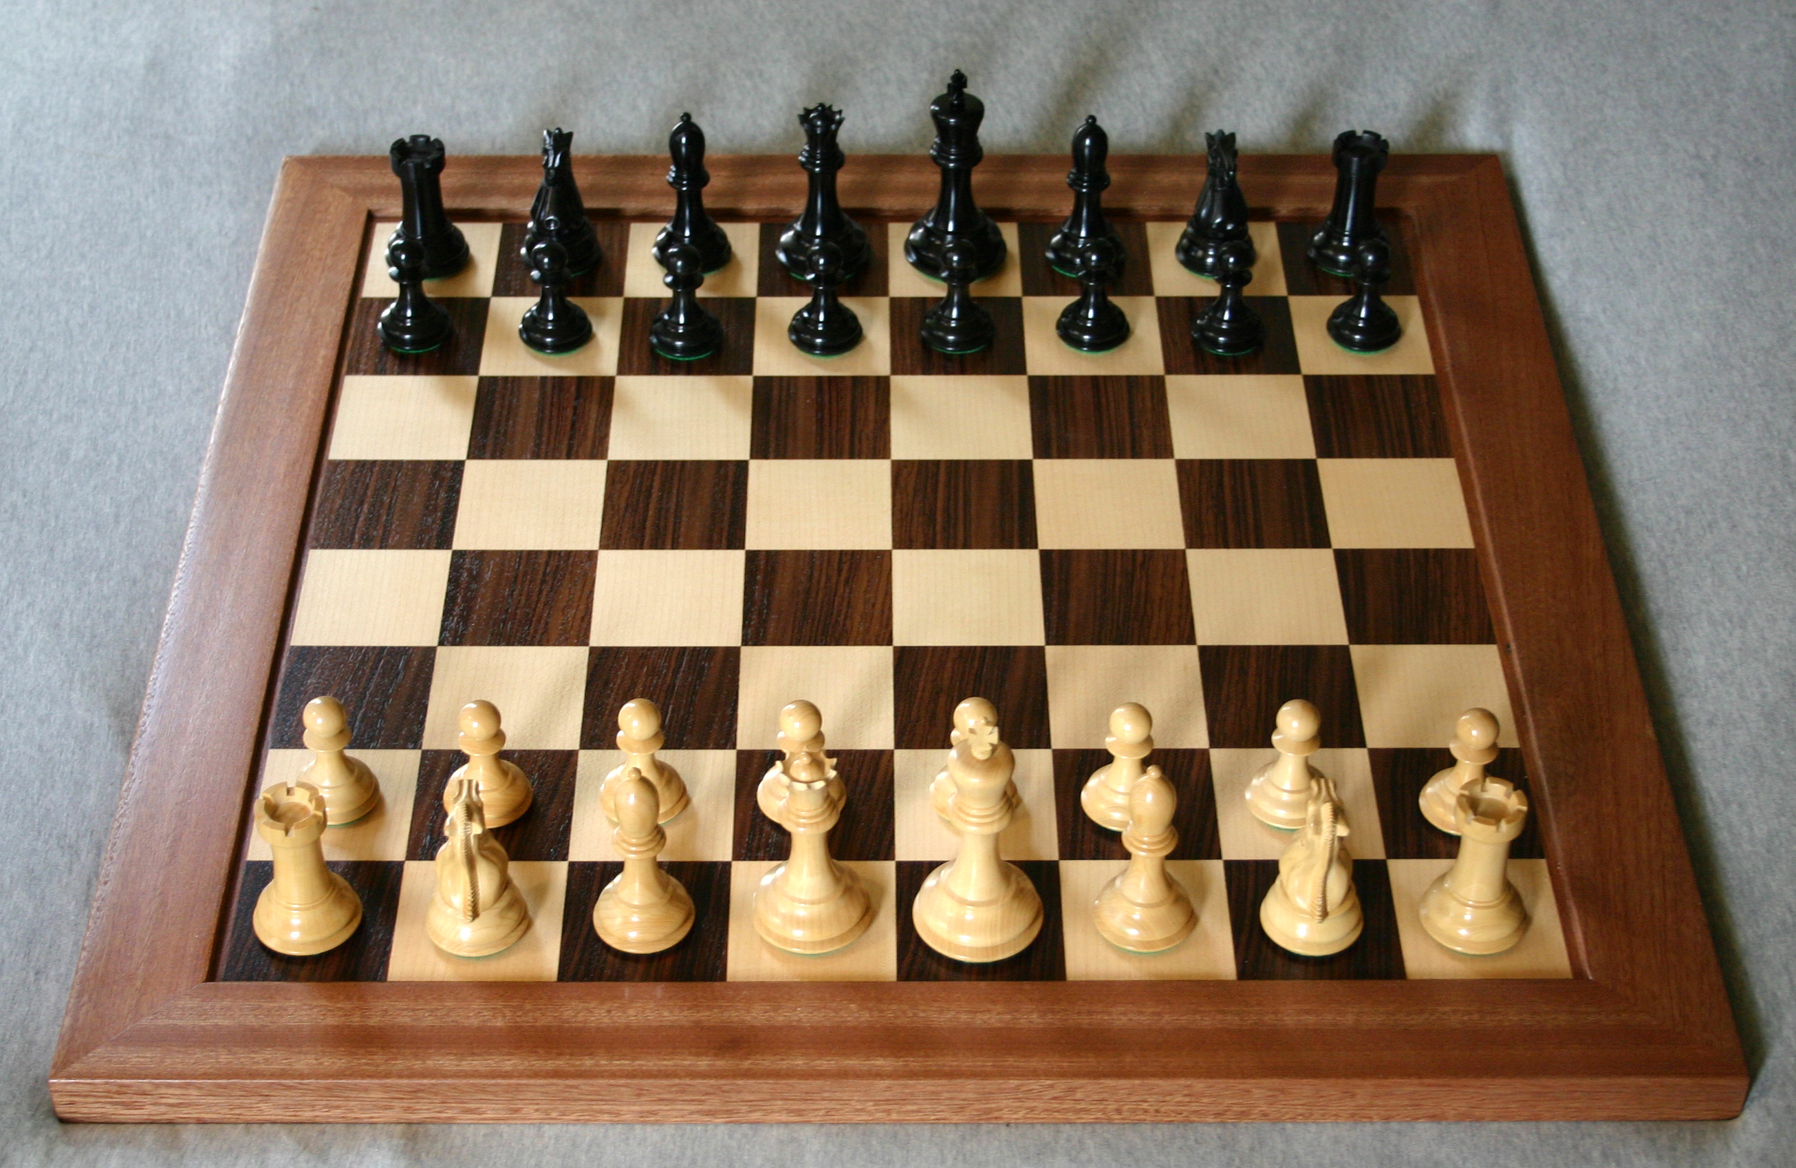
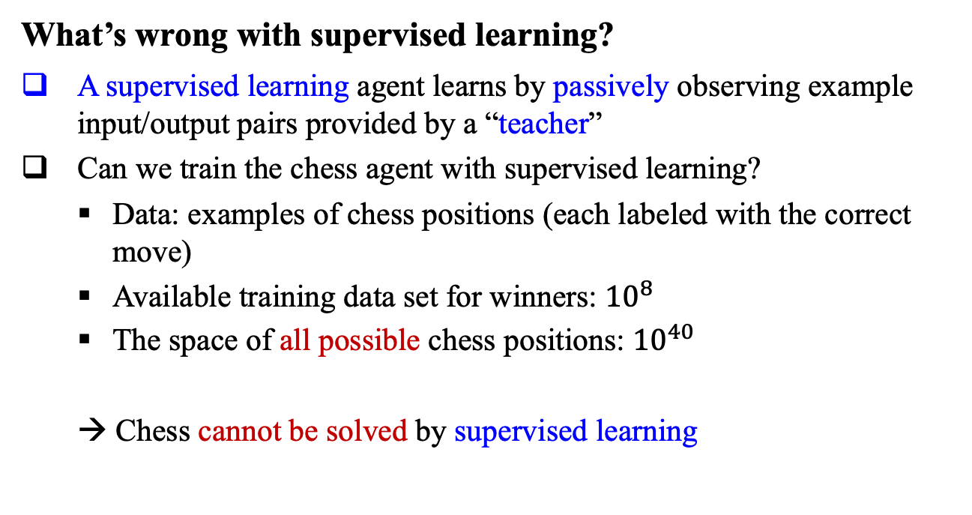
Problems with Supervised Learning
What’s wrong with supervised learning?
A supervised learning agent learns by passively observing example input/output pairs provided by a “teacher”
Can we train the chess agent with supervised learning?
Data: examples of chess positions (each labeled with the correct move)
Available training data set for winners: ${10}^{8}$
The space of all possible chess positions: ${10}^{40}$
→ Chess cannot be solved by supervised learning

Slide 5
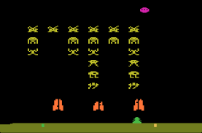
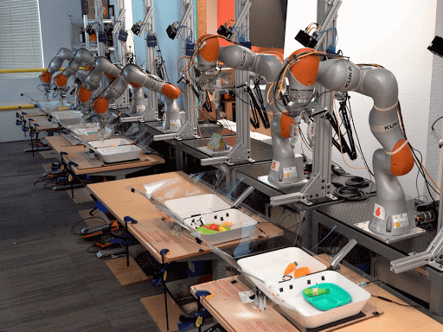
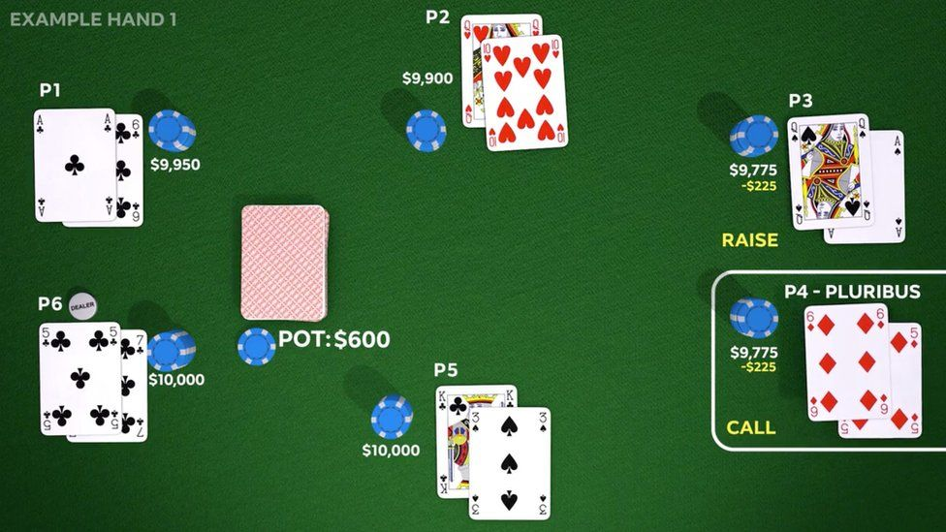
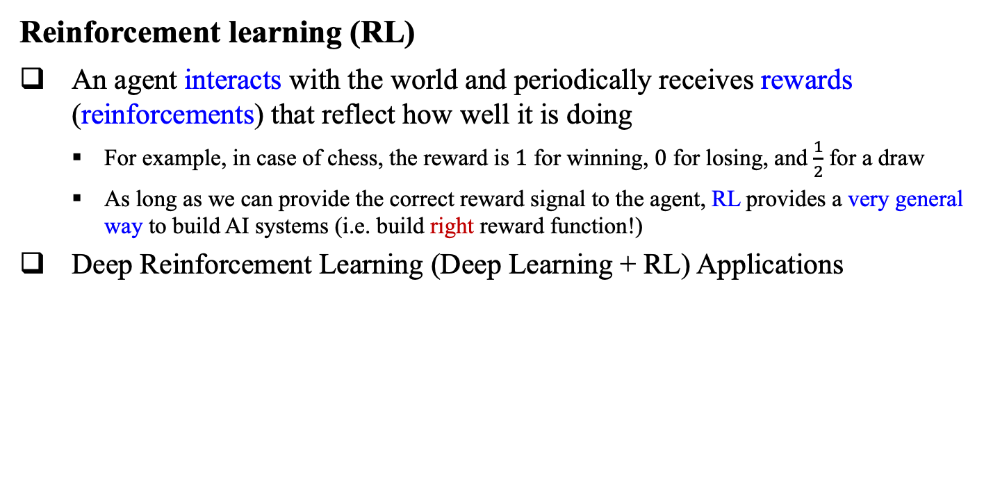
Reinforcement Learning
Reinforcement learning (RL)
An agent interacts with the world and periodically receives rewards (reinforcements) that reflect how well it is doing
For example, in case of chess, the reward is $1$ for winning, $0$ for losing, and $\frac{1}{2}$ for a draw
As long as we can provide the correct reward signal to the agent, RL provides a very general way to build AI systems (i.e. build right reward function!)
Deep Reinforcement Learning (Deep Learning + RL) Applications
Deep Q-learning (Mnih et al., 2013)
Multi-task Robotic RL (Chebotar et al., 2021)
Poker AI (Brown et al., 2017)

Slide 6
Lecture 17 Reinforcement Learning
Reinforcement Learning
Model-based vs. Model-free
Passive learning agent vs. Active learning agent
Exploration vs. Safe exploration
Exploration, Exploitation, Bayesian RL
Generalization in Reinforcement Learning
Function approximation, Deep RL, Reward shaping, Hierarchical RL
Apprenticeship Learning
Imitation learning, Inverse reinforcement learning

Slide 7
Outline (Lecture 17)
17.1 Learning from Rewards ……….……….……….………..
17.2 Passive Reinforcement Learning …………………………
17.3 Active Reinforcement Learning ………….………….…...
17.4 Generalization in Reinforcement Learning ……….……...
17.5 Policy Search …………….……..…….………..……..….
17.6 Apprenticeship and Inverse Reinforcement Learning ……
17.7 Applications of Reinforcement Learning ……………..….
Summary ……………….………………………….…….……..
7
12
19
28
35
38
41
43

Slide 8
17.1 Learning from Rewards

Slide 9
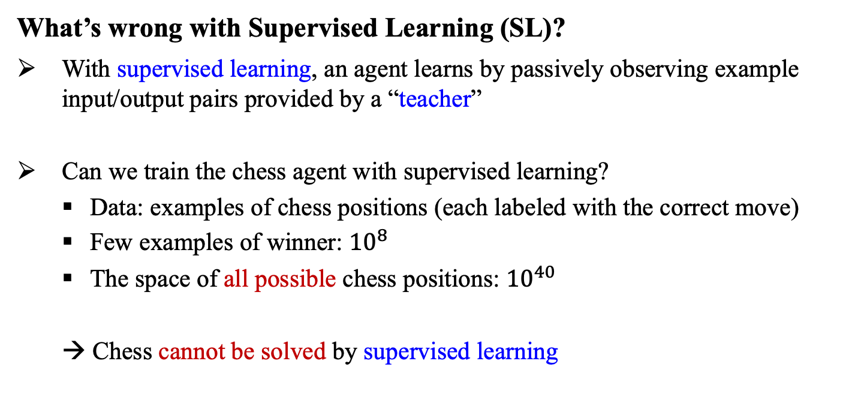
17.1 Learning from Rewards (1/4)
What’s wrong with Supervised Learning (SL)?
With supervised learning, an agent learns by passively observing example input/output pairs provided by a “teacher”
Can we train the chess agent with supervised learning?
Data: examples of chess positions (each labeled with the correct move)
Few examples of winner: ${10}^{8}$
The space of all possible chess positions: ${10}^{40}$
→ Chess cannot be solved by supervised learning

Slide 10
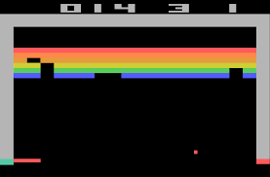
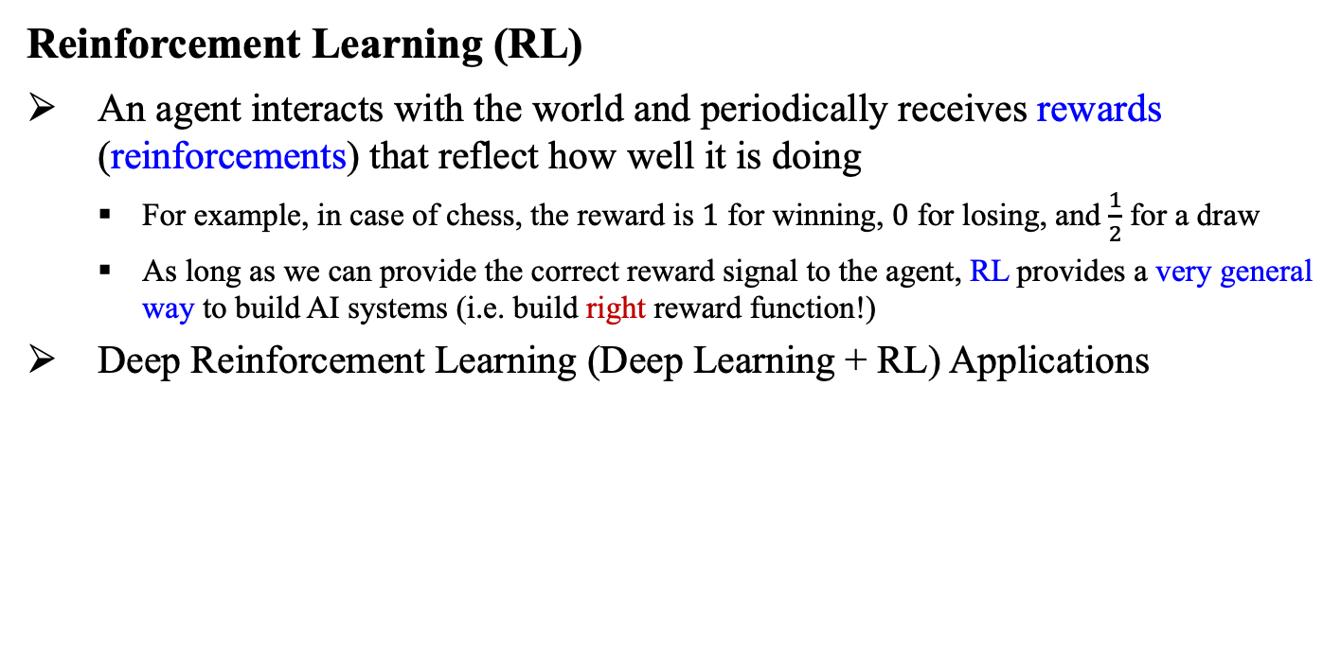
17.1 Learning from Rewards (2/4)
Reinforcement Learning (RL)
An agent interacts with the world and periodically receives rewards (reinforcements) that reflect how well it is doing
For example, in case of chess, the reward is $1$ for winning, $0$ for losing, and $\frac{1}{2}$ for a draw
As long as we can provide the correct reward signal to the agent, RL provides a very general way to build AI systems (i.e. build right reward function!)
Deep Reinforcement Learning (Deep Learning + RL) Applications
Deep Q-learning (Mnih et al., 2013)
Multi-task Robotic RL (Chebotar et al., 2021)
Poker AI (Brown et al., 2017)

Slide 11
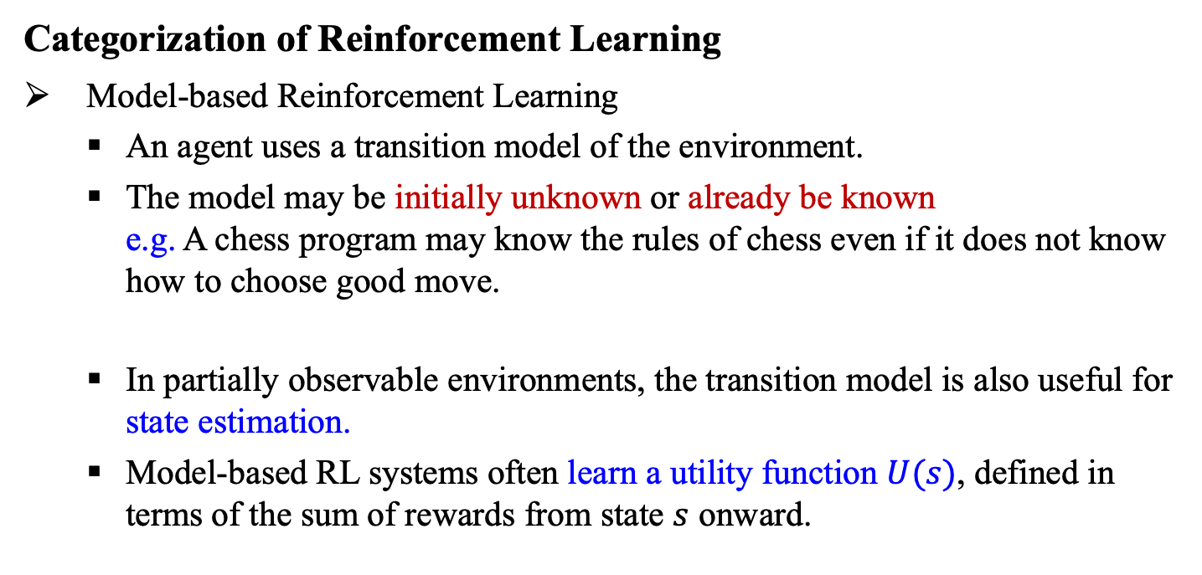
17.1 Learning from Rewards (3/4)
Categorization of Reinforcement Learning
Model-based Reinforcement Learning
An agent uses a transition model of the environment.
The model may be initially unknown or already be known e.g. A chess program may know the rules of chess even if it does not know how to choose good move.
In partially observable environments, the transition model is also useful for state estimation.
Model-based RL systems often learn a utility function $U(s)$, defined in terms of the sum of rewards from state $s$ onward.

Slide 12
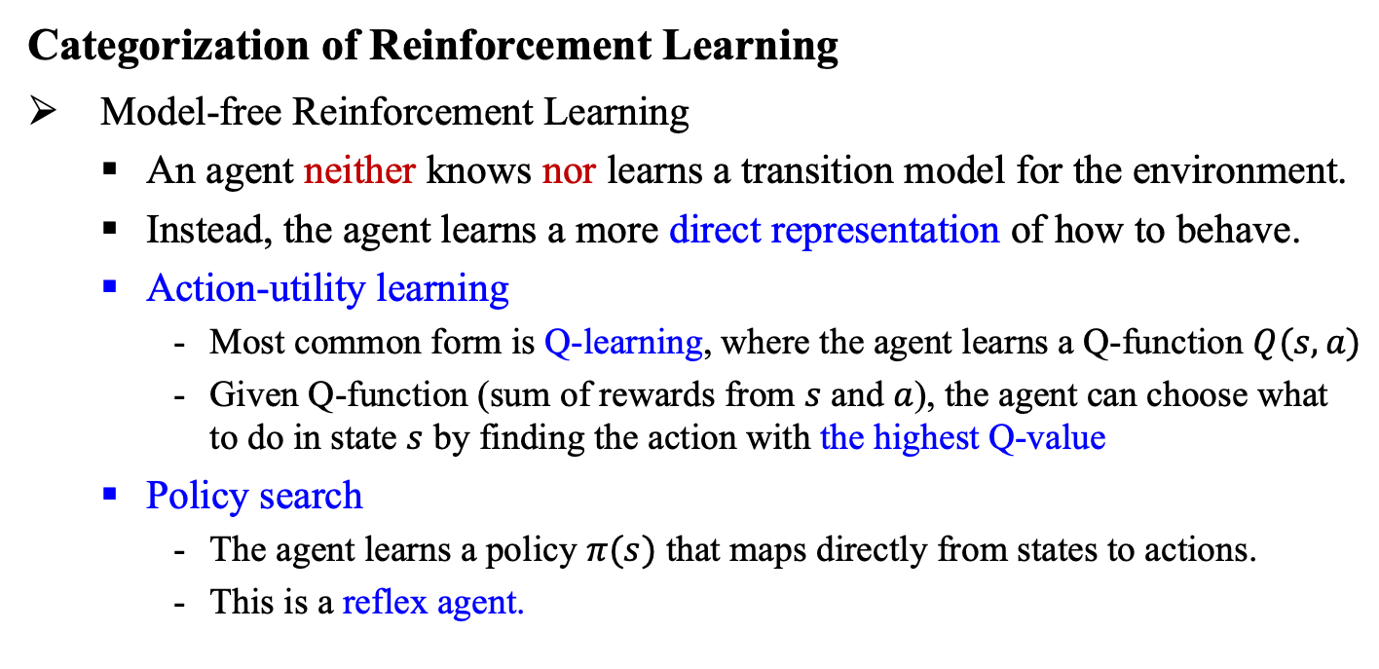
17.1 Learning from Rewards (4/4)
Categorization of Reinforcement Learning
Model-free Reinforcement Learning
An agent neither knows nor learns a transition model for the environment.
Instead, the agent learns a more direct representation of how to behave.
Action-utility learning
Most common form is Q-learning, where the agent learns a Q-function $Q(s,a)$
Given Q-function (sum of rewards from $s$ and $a$), the agent can choose what to do in state $s$ by finding the action with the highest Q-value
Policy search
The agent learns a policy $π(s)$ that maps directly from states to actions.
This is a reflex agent.

Slide 13
17.2 Passive Reinforcement Learning

Slide 14
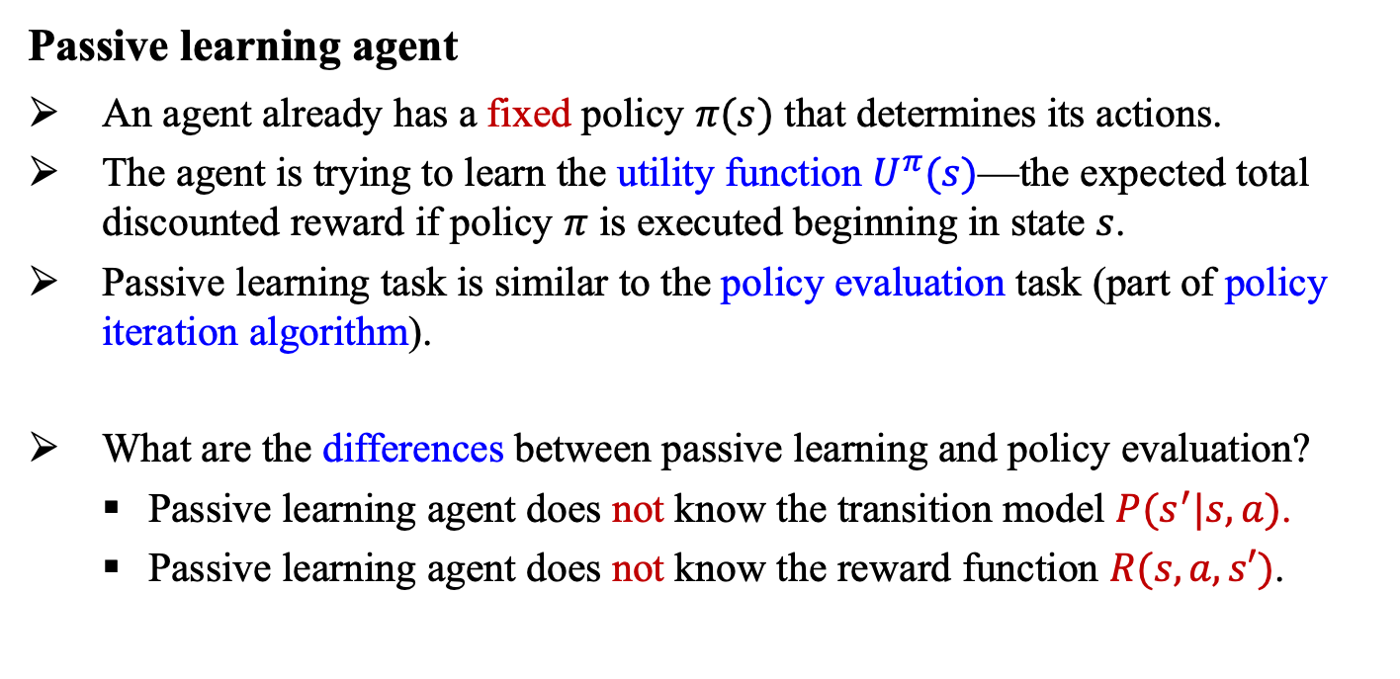
17.2 Passive Reinforcement Learning (1/6)
Passive learning agent
An agent already has a fixed policy $π(s)$ that determines its actions.
The agent is trying to learn the utility function $U^{π}(s)$—the expected total discounted reward if policy $π$ is executed beginning in state $s$.
Passive learning task is similar to the policy evaluation task (part of policy iteration algorithm).
What are the differences between passive learning and policy evaluation?
Passive learning agent does not know the transition model $P(s^{′}|s,a)$.
Passive learning agent does not know the reward function $R(s,a,s′)$.

Slide 15
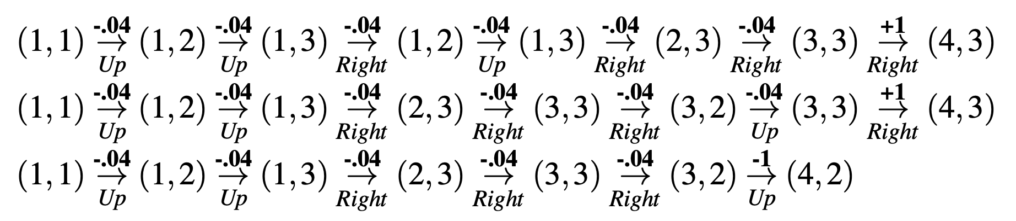
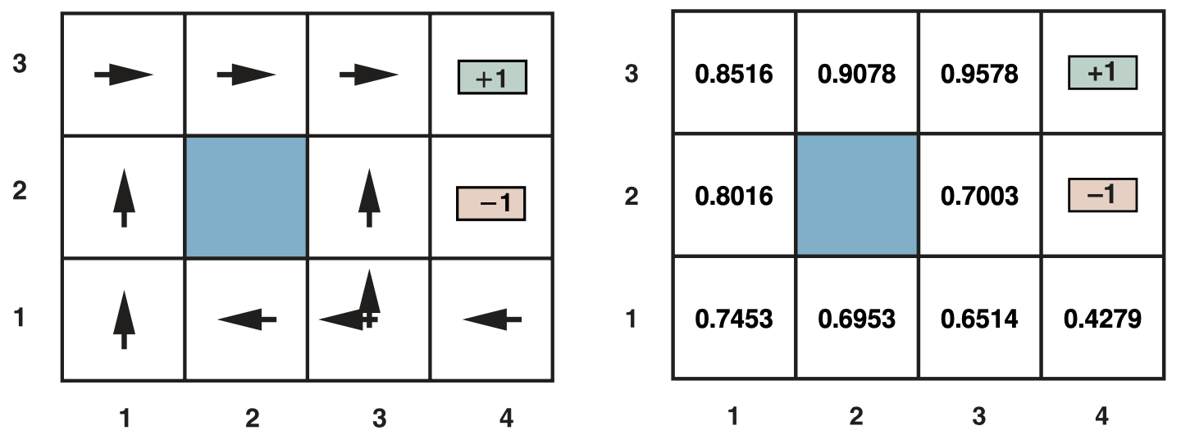
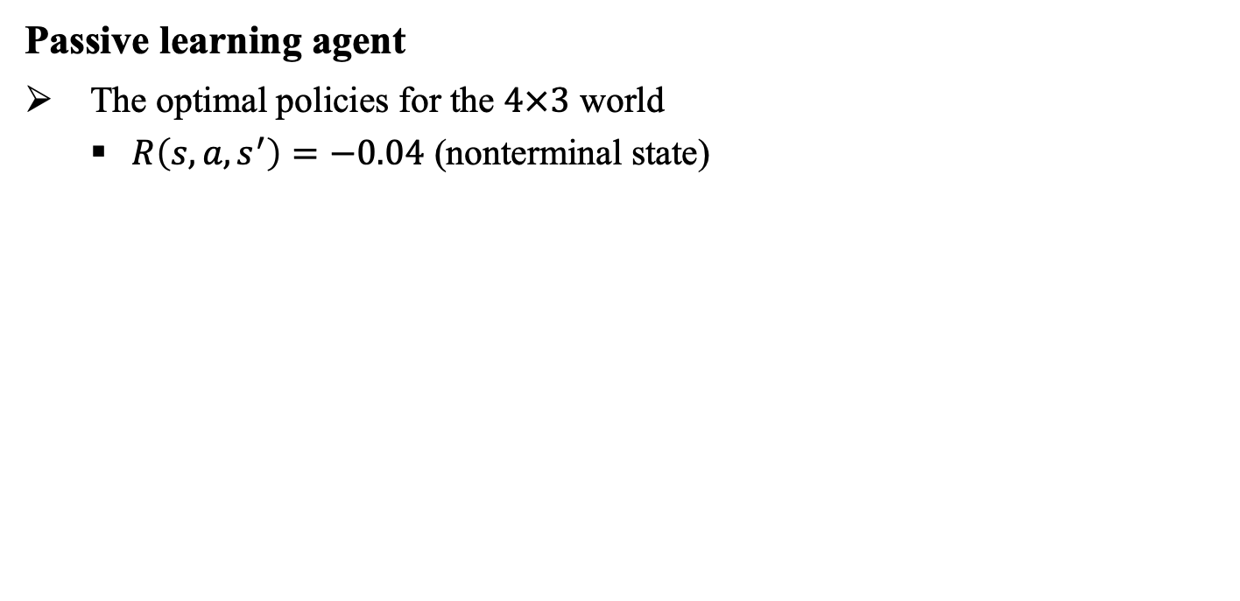
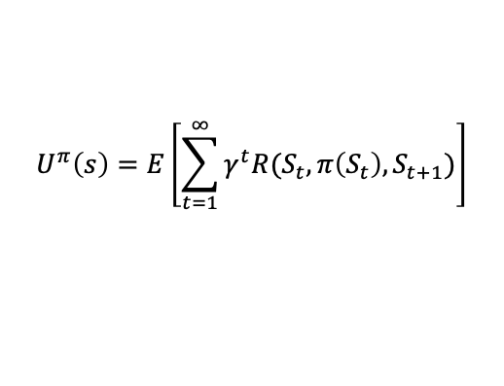
17.2 Passive Reinforcement Learning (2/6)
Passive learning agent
The optimal policies for the $4×3$ world
$R\left(s,a,s^{′}\right)=−0.04$ (nonterminal state)
$$U^{π}\left(s\right)=E\left[\sum_{t=1}^{∞}{γ^{t}R(S_{t},π\left(S_{t}\right),S_{t+1})}\right]$$

Slide 16
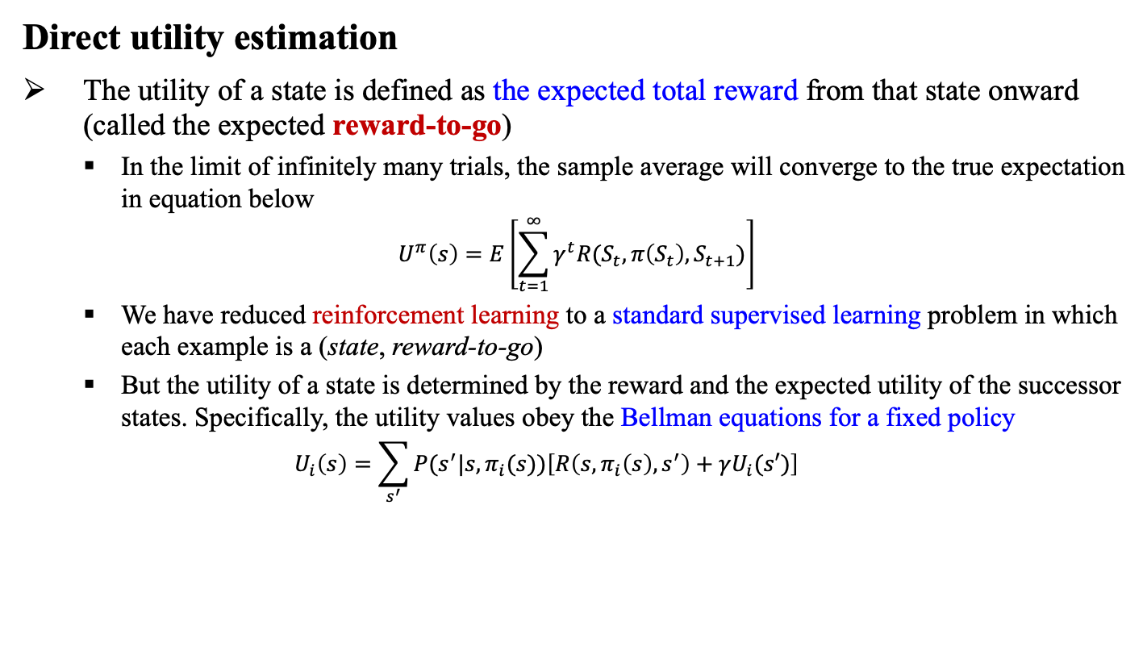
17.2 Passive Reinforcement Learning (3/6)
Direct utility estimation
The utility of a state is defined as the expected total reward from that state onward (called the expected reward-to-go)
In the limit of infinitely many trials, the sample average will converge to the true expectation in equation below
$$U^{π}\left(s\right)=E\left[\sum_{t=1}^{∞}{γ^{t}R(S_{t},π\left(S_{t}\right),S_{t+1})}\right]$$
We have reduced reinforcement learning to a standard supervised learning problem in which each example is a (state, reward-to-go)
But the utility of a state is determined by the reward and the expected utility of the successor states. Specifically, the utility values obey the Bellman equations for a fixed policy
$$U_{i}\left(s\right)=\sum_{s^{′}}{P(s^{′}|s,π_{i}(s))\left[R\left(s,π_{i}\left(s\right),s^{′}\right)+γU_{i}(s′)\right]}$$

Slide 17
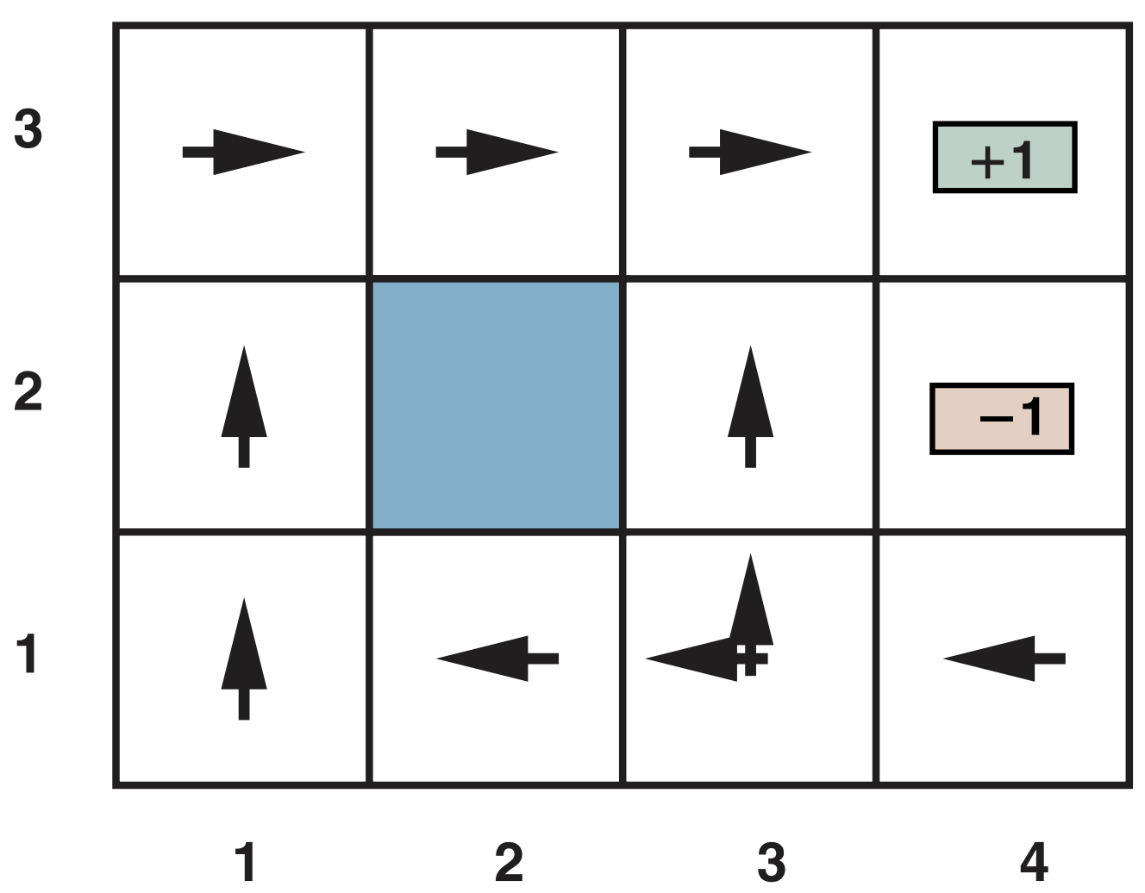
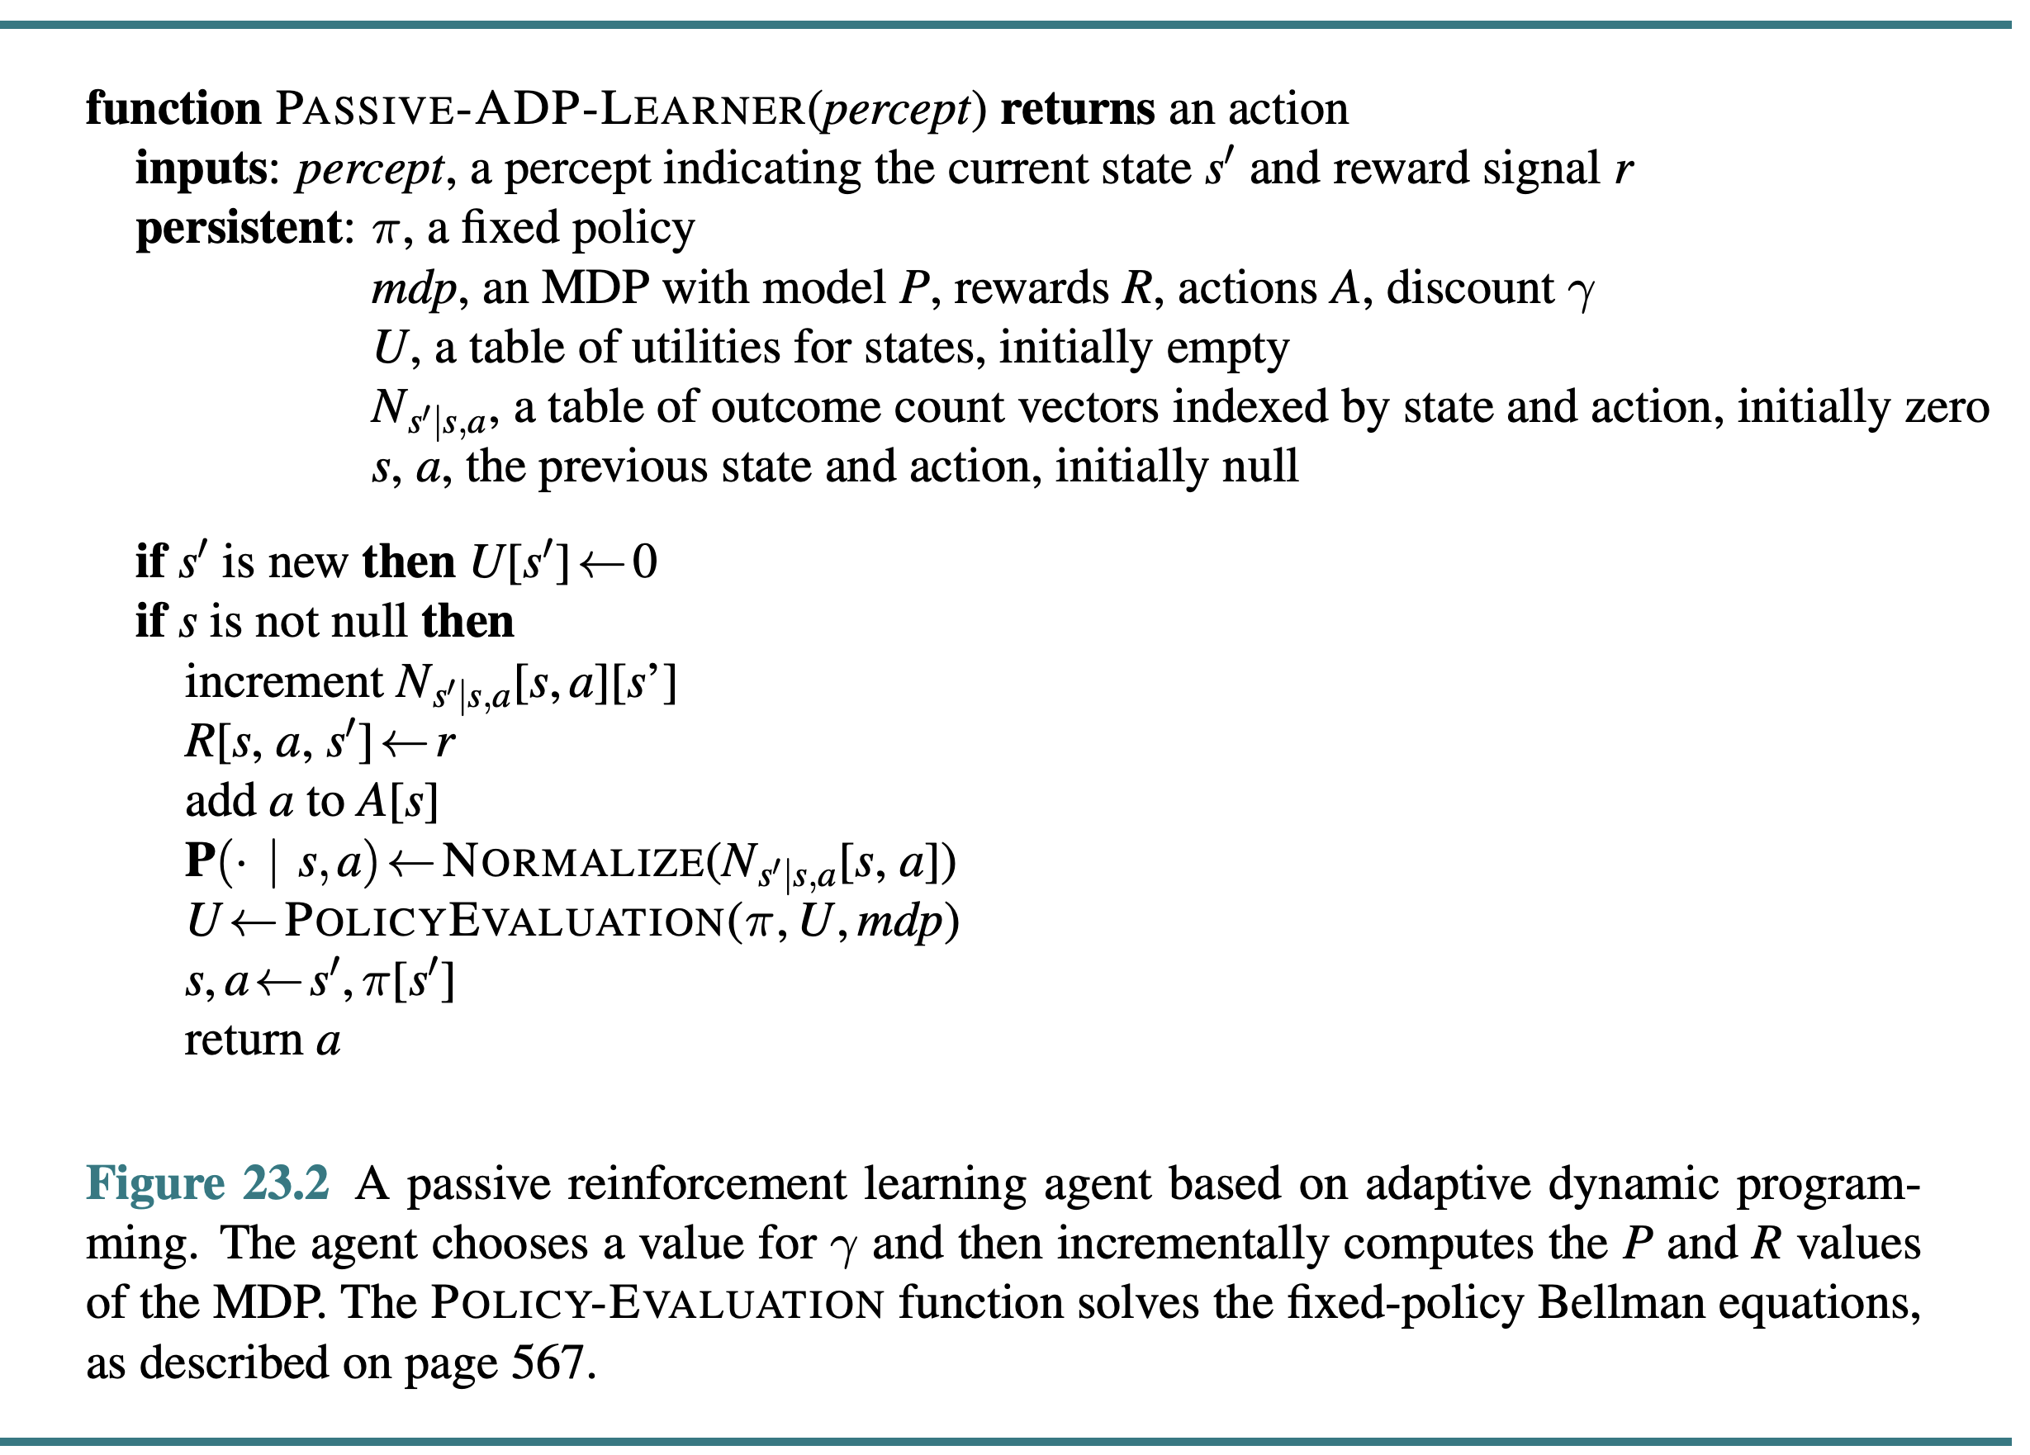
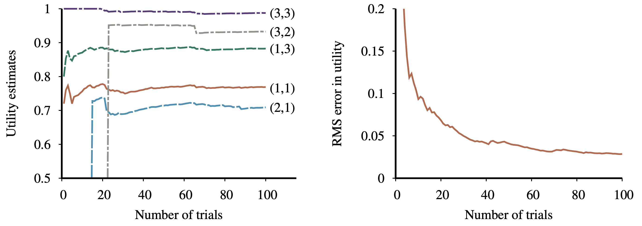
17.2 Passive Reinforcement Learning (4/6)
Adaptive dynamic programming (ADP)
ADP agent takes advantage of the constraints among the utilities of the states by learning the transition model that connects them and solving the corresponding Markov decision process (MDP) using dynamic programming.

Slide 18
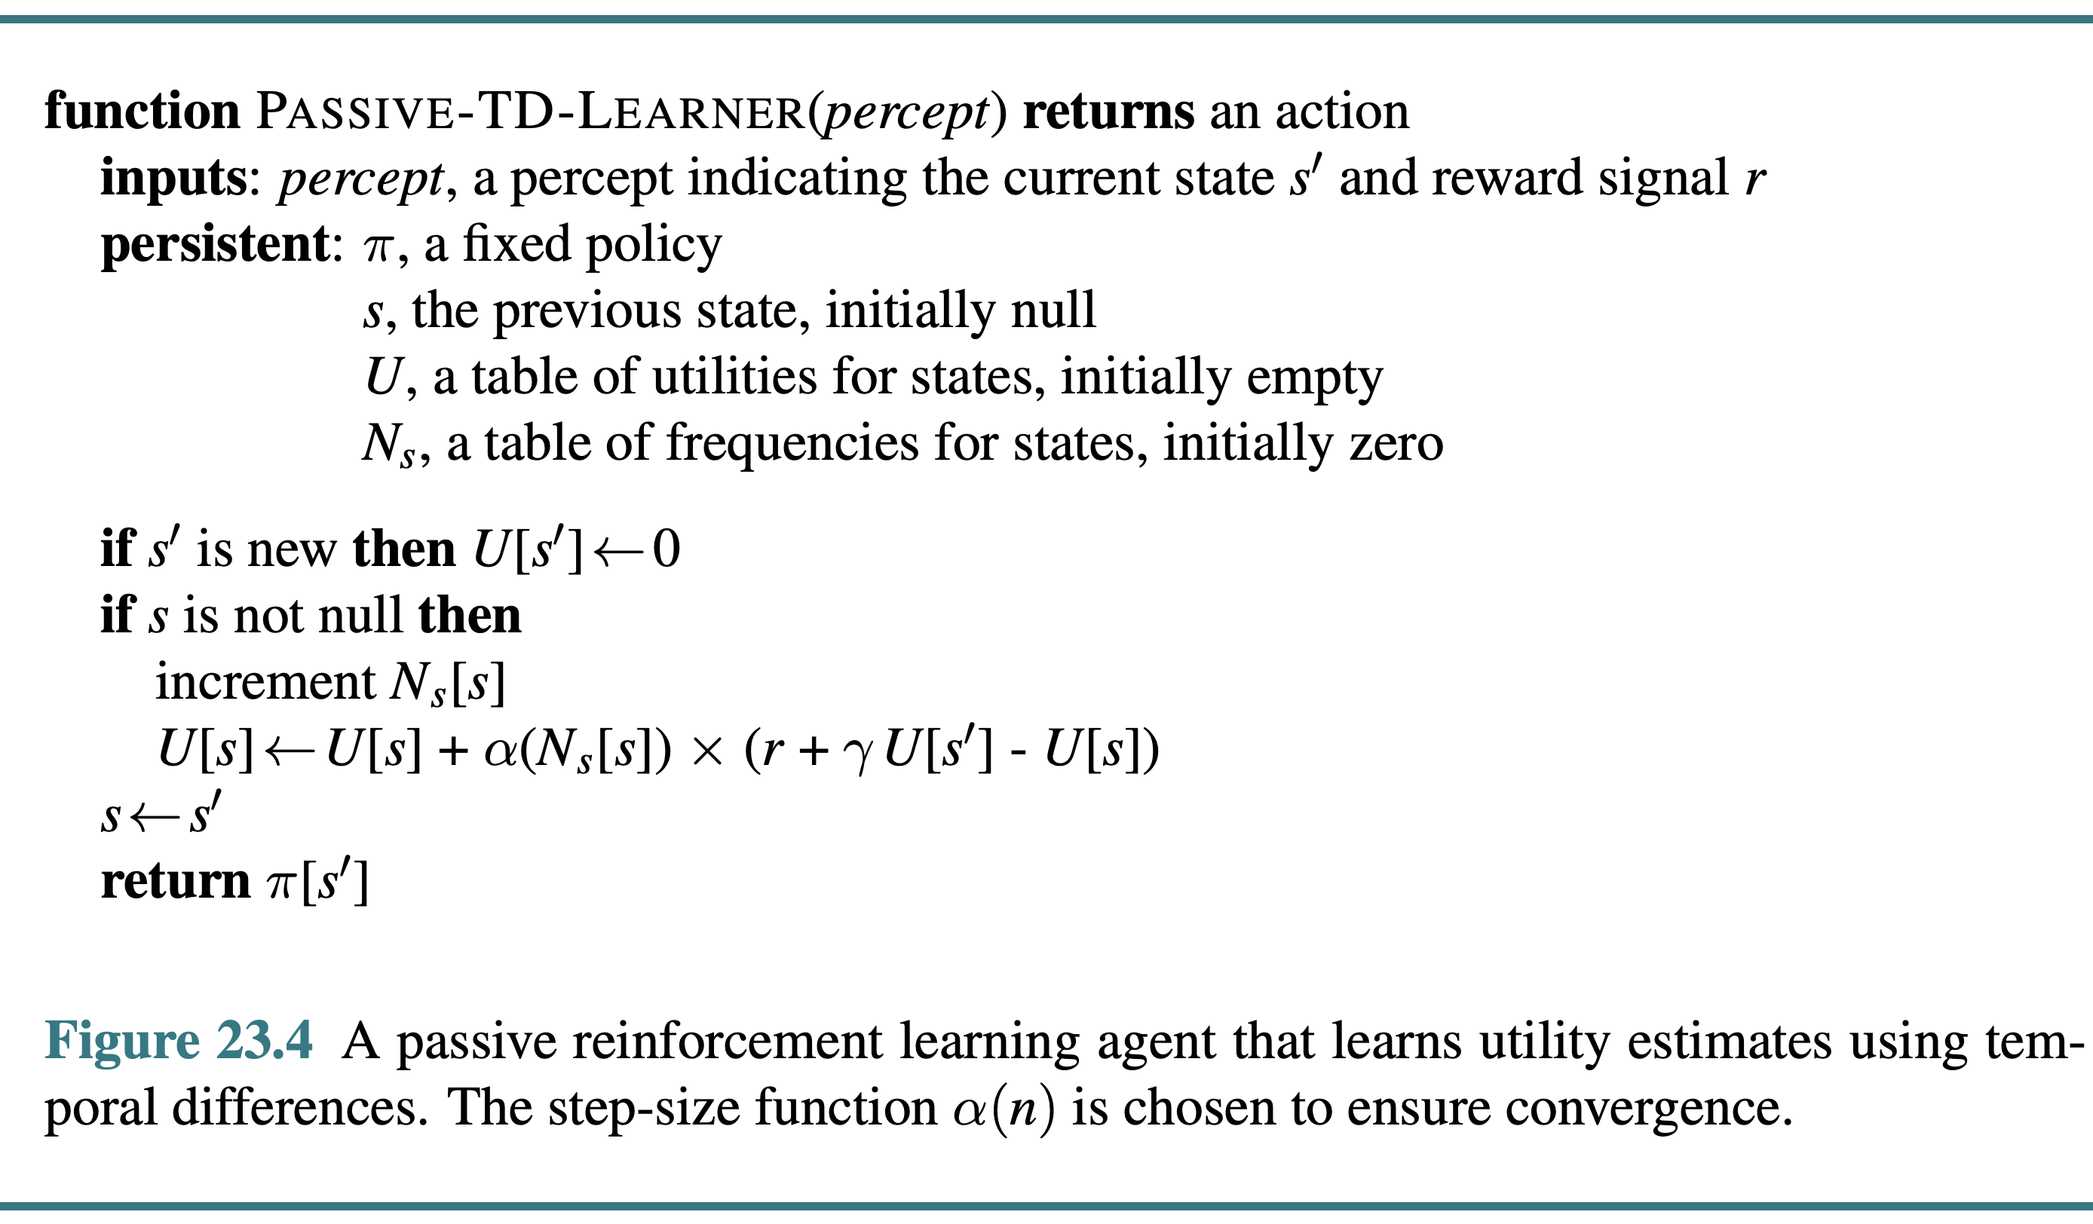
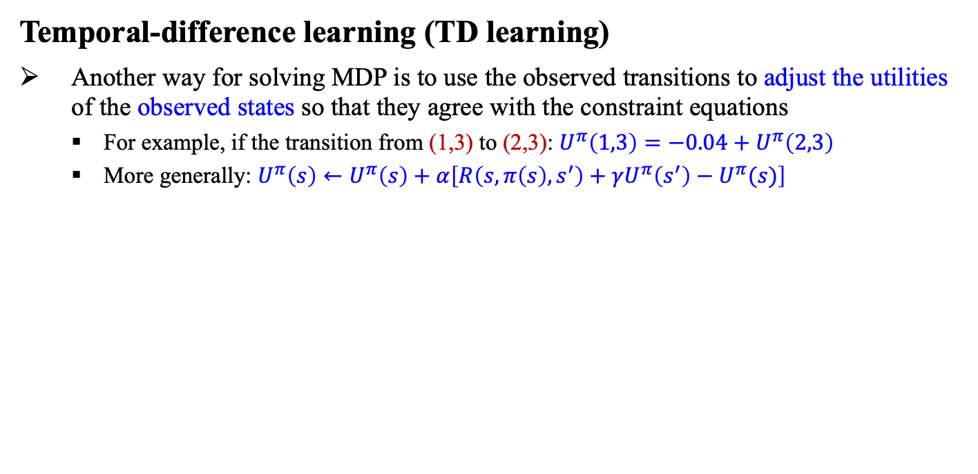
17.2 Passive Reinforcement Learning (5/6)
Temporal-difference learning (TD learning)
Another way for solving MDP is to use the observed transitions to adjust the utilities of the observed states so that they agree with the constraint equations
For example, if the transition from (1,3) to (2,3): $U^{π}\left(1,3\right)=−0.04+U^{π}\left(2,3\right)$
More generally: $U^{π}\left(s\right)←U^{π}\left(s\right)+α\left[R\left(s,π\left(s\right),s^{′}\right)+γU^{π}\left(s^{′}\right)−U^{π}(s)\right]$
(1,3)
(2,3)

Slide 19
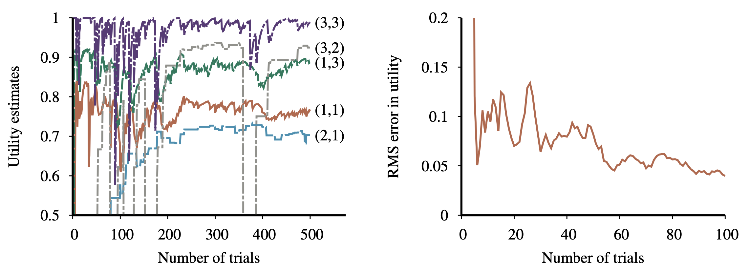
17.2 Passive Reinforcement Learning (6/6)
Temporal-difference learning (TD learning)

Slide 20
17.3 Active Reinforcement Learning

Slide 21
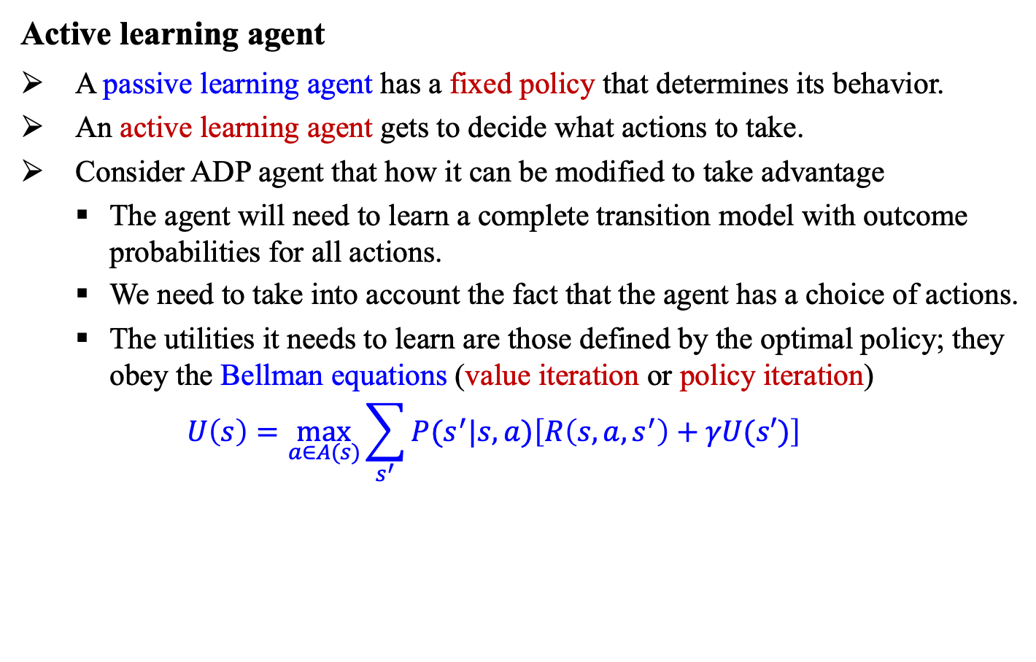
17.3 Active Reinforcement Learning (1/8)
Active learning agent
A passive learning agent has a fixed policy that determines its behavior.
An active learning agent gets to decide what actions to take.
Consider ADP agent that how it can be modified to take advantage
The agent will need to learn a complete transition model with outcome probabilities for all actions.
We need to take into account the fact that the agent has a choice of actions.
The utilities it needs to learn are those defined by the optimal policy; they obey the Bellman equations (value iteration or policy iteration)
$$U\left(s\right)=\max_{a∈A(s)}{\sum_{s^{′}}{P(s^{′}|s,a)\left[R\left(s,a,s^{′}\right)+γU(s′)\right]}}$$

Slide 22
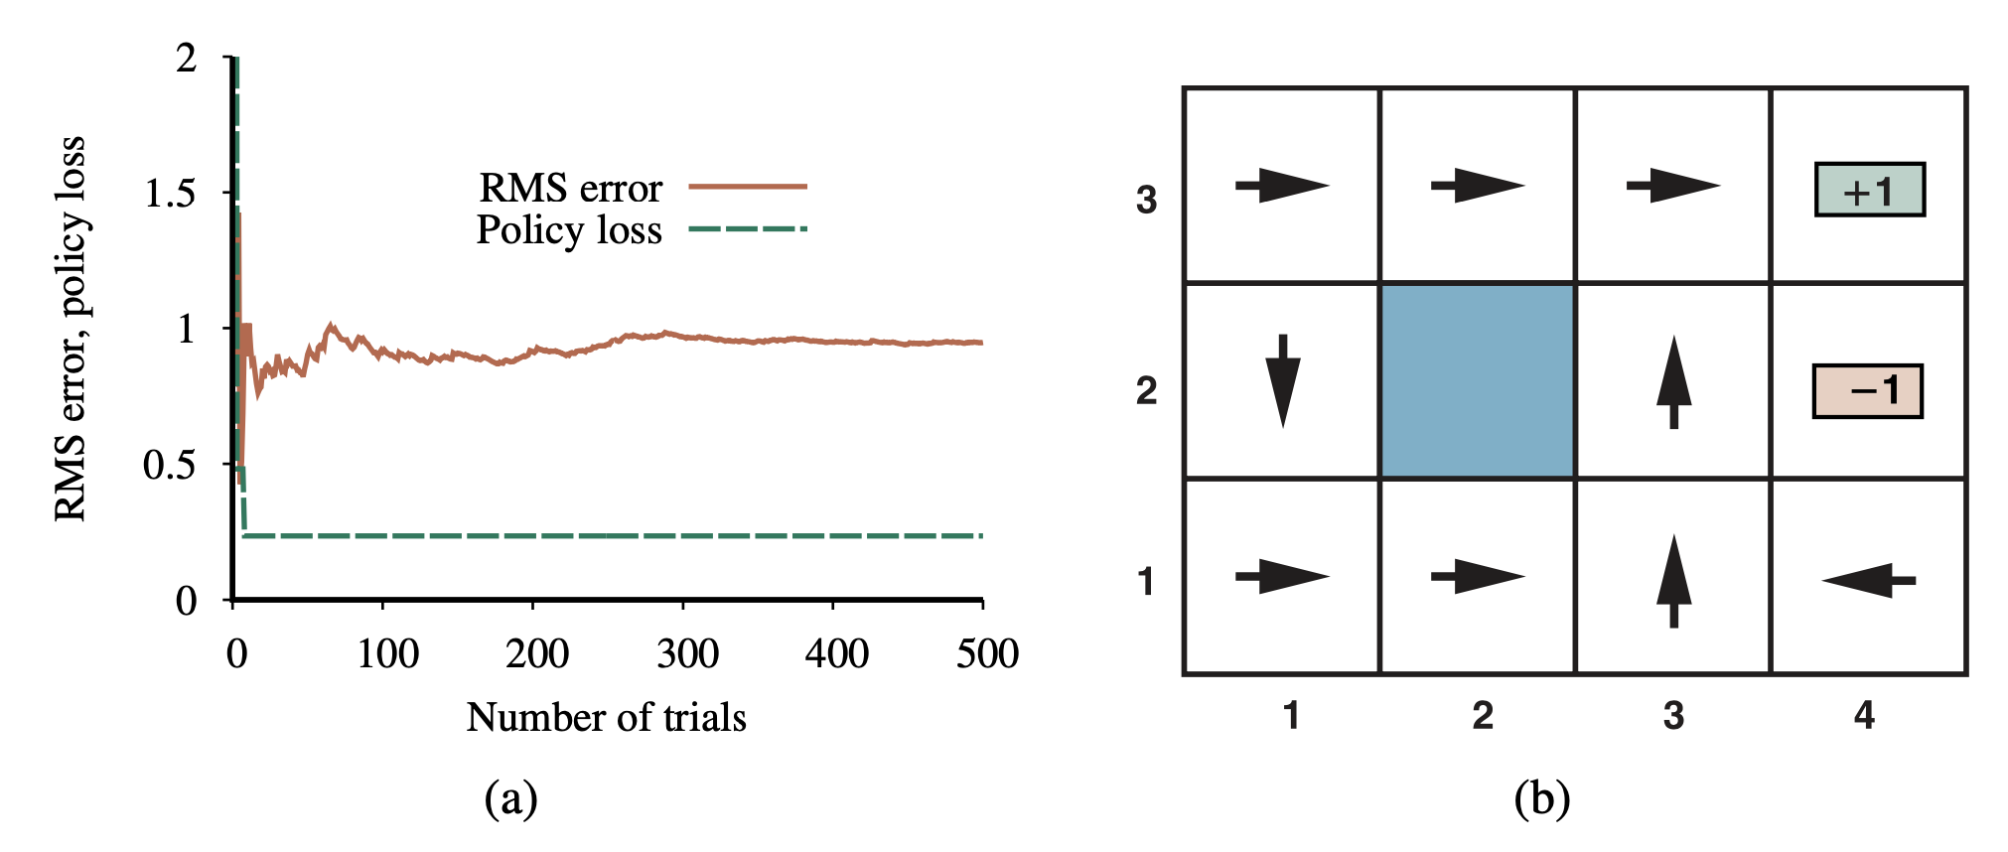
17.3 Active Reinforcement Learning (2/8)
Active learning agent
The greedy agent does not learn the true utilities or the true optimal policy! Then, what should it do?
<출처> Stuart J. Russell and Peter Norvig (2021). Artificial Intelligence: A Modern Approach (4th Edition). Pearson

Slide 23
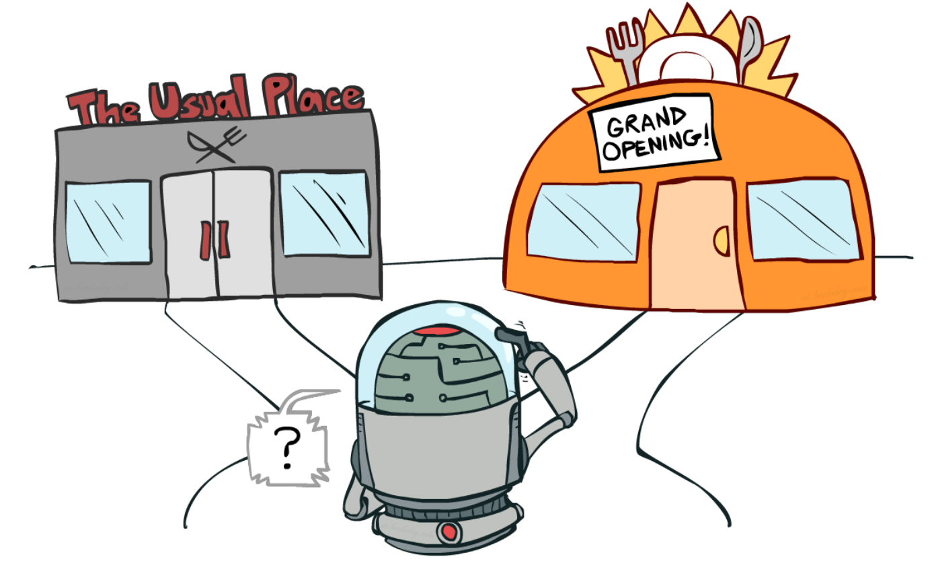
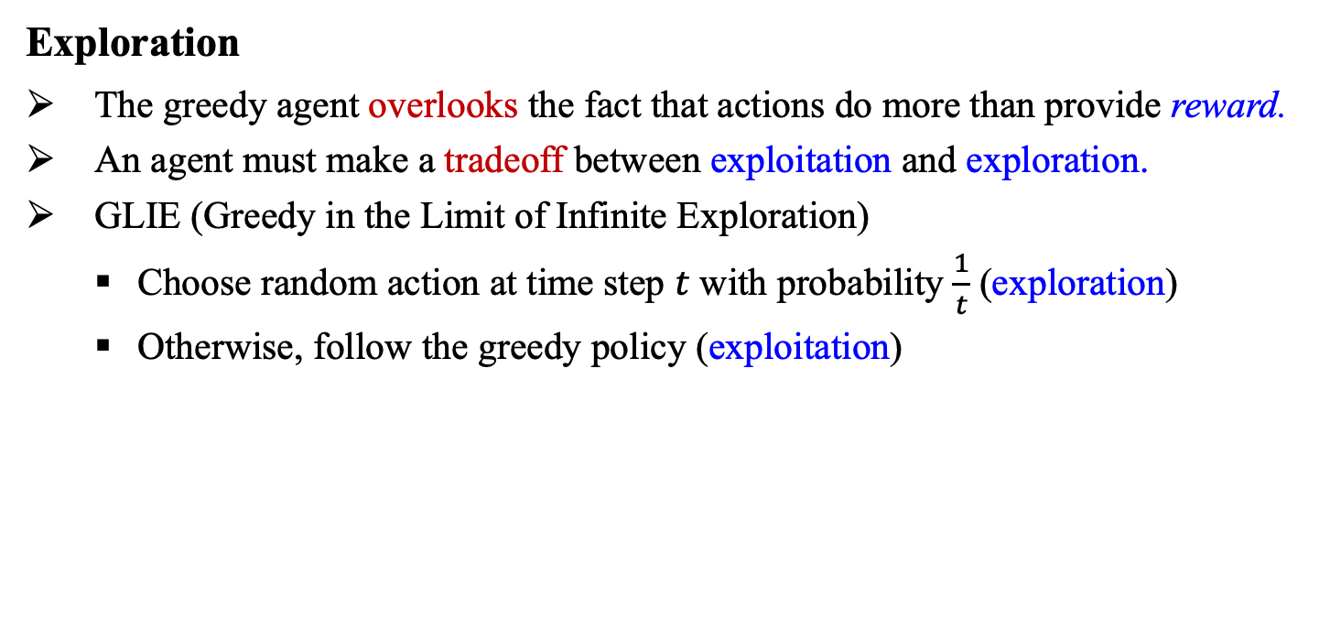
17.3 Active Reinforcement Learning (3/8)
Exploration
The greedy agent overlooks the fact that actions do more than provide reward.
An agent must make a tradeoff between exploitation and exploration.
GLIE (Greedy in the Limit of Infinite Exploration)
Choose random action at time step $t$ with probability $\frac{1}{t}$ (exploration)
Otherwise, follow the greedy policy (exploitation)
<출처> Avery Parkinson’ blog: The epsilon-greedy algorithms for reinforcement learning

Slide 24
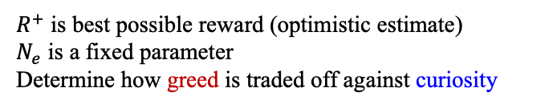
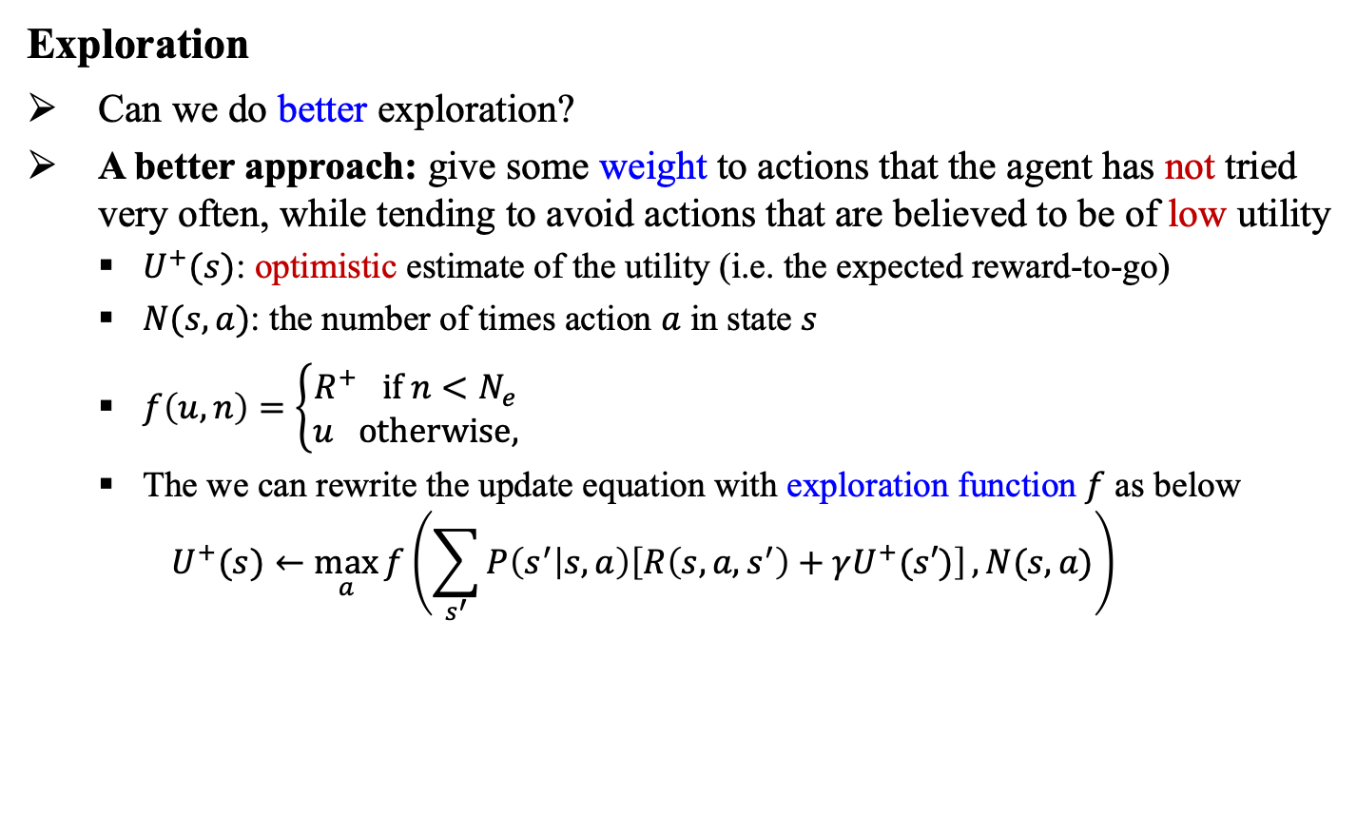
17.3 Active Reinforcement Learning (4/8)
Exploration
Can we do better exploration?
A better approach: give some weight to actions that the agent has not tried very often, while tending to avoid actions that are believed to be of low utility
$U^{+}(s)$: optimistic estimate of the utility (i.e. the expected reward-to-go)
$N(s,a)$: the number of times action $a$ in state $s$
$f\left(u,n\right)=\left\{\begin{aligned}R^{+} if n<N_{e} \\ u otherwise,\end{aligned}\right.$
The we can rewrite the update equation with exploration function $f$ as below
$$U^{+}(s)←\max_{a}{f\left(\sum_{s^{′}}{P\left(s^{′} | s,a\right)\left[R\left(s,a,s^{′}\right)+γU^{+}(s′)\right]},N(s,a)\right)}$$
$R^{+}$ is best possible reward (optimistic estimate)
$N_{e}$ is a fixed parameter
Determine how greed is traded off against curiosity

Slide 25
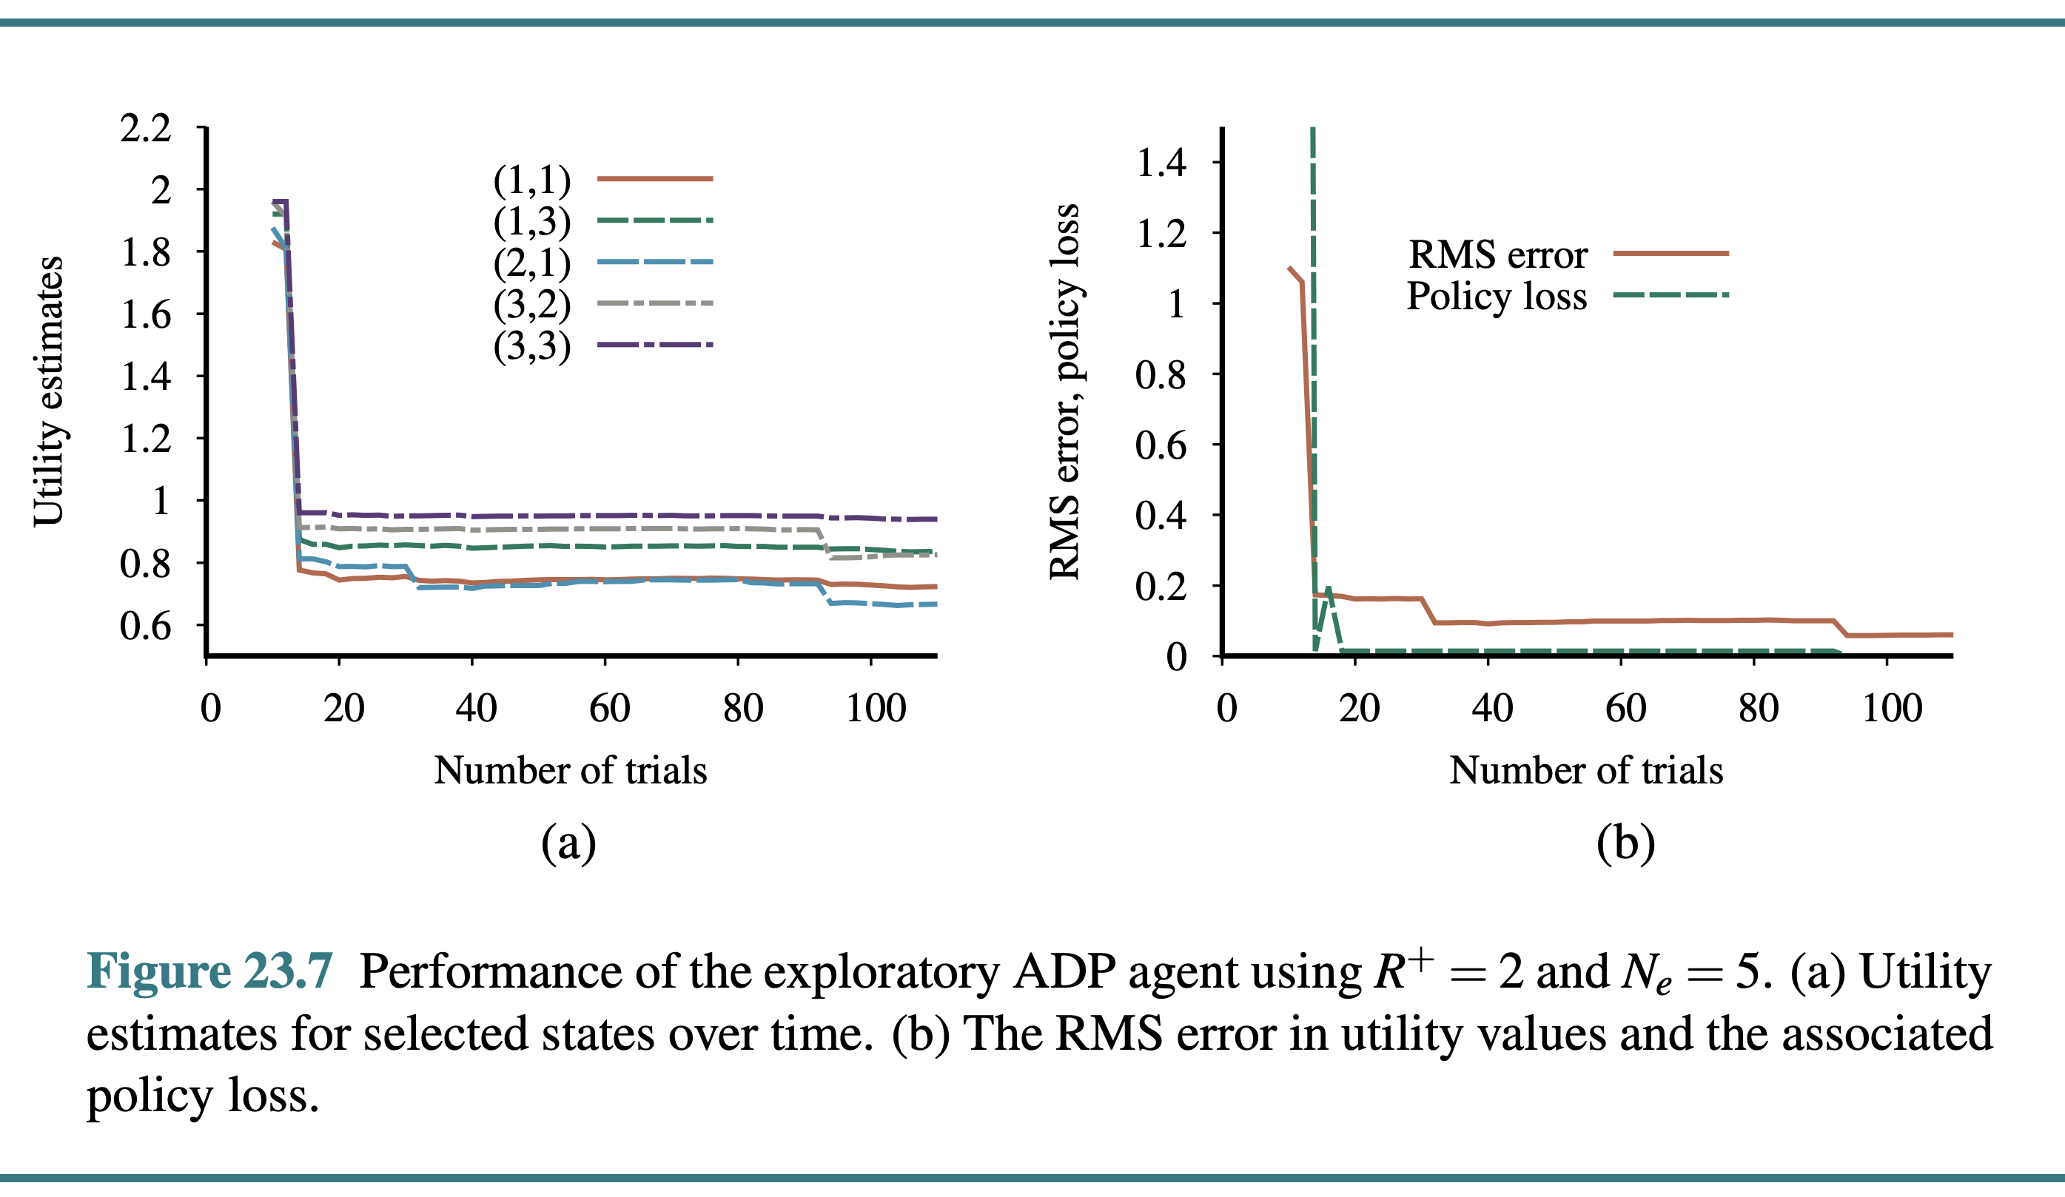
17.3 Active Reinforcement Learning (5/8)
Exploration
An agent with exploration shows a rapid convergence toward zero policy loss (unlikely with the greedy approach)

Slide 26
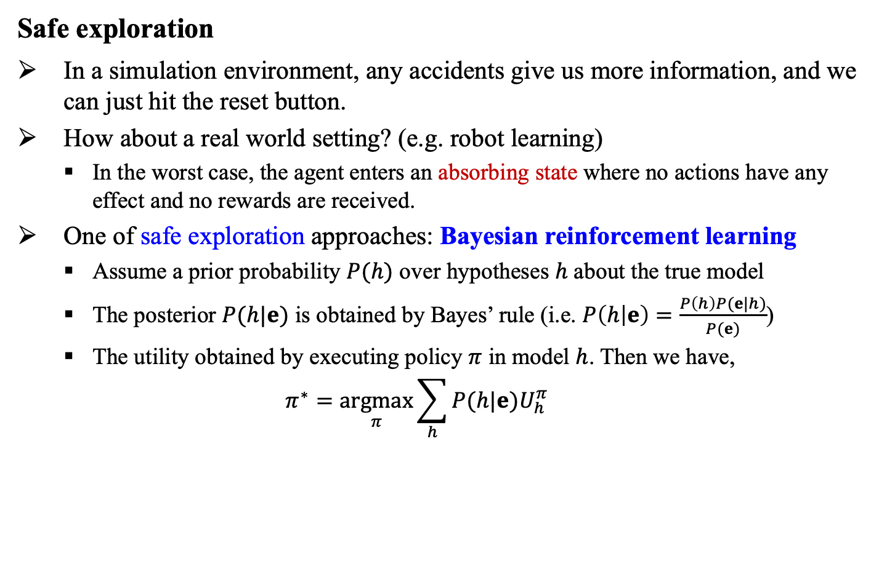
17.3 Active Reinforcement Learning (6/8)
Safe exploration
In a simulation environment, any accidents give us more information, and we can just hit the reset button.
How about a real world setting? (e.g. robot learning)
In the worst case, the agent enters an absorbing state where no actions have any effect and no rewards are received.
One of safe exploration approaches: Bayesian reinforcement learning
Assume a prior probability $P(h)$ over hypotheses $h$ about the true model
The posterior $P(h|e)$ is obtained by Bayes’ rule (i.e. $P\left(h | e\right)=\frac{P\left(h\right)P(e|h)}{P(e)}$)
The utility obtained by executing policy $π$ in model $h$. Then we have,
$$π^{∗}=\underset{π}{argmax}{\sum_{h}{P(h|e)U_{h}^{π}}}$$

Slide 27
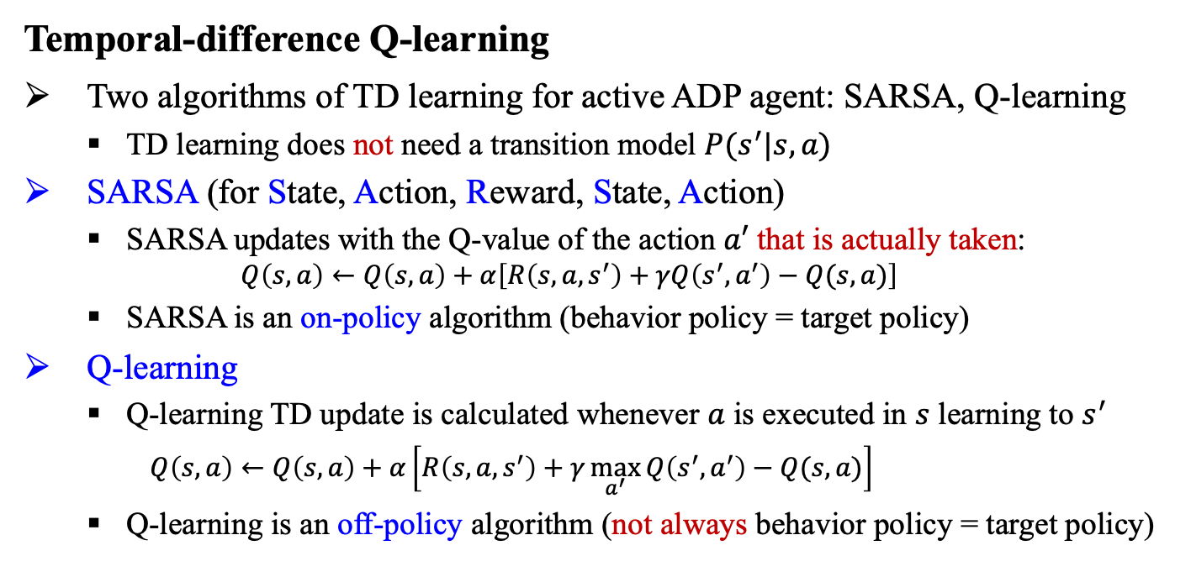
17.3 Active Reinforcement Learning (7/8)
Temporal-difference Q-learning
Two algorithms of TD learning for active ADP agent: SARSA, Q-learning
TD learning does not need a transition model $P(s^{′}|s,a)$
SARSA (for State, Action, Reward, State, Action)
SARSA updates with the Q-value of the action $a′$ that is actually taken:
$$Q\left(s,a\right)←Q\left(s,a\right)+α\left[R\left(s,a,s^{′}\right)+γQ\left(s^{′},a^{′}\right)−Q(s,a)\right]$$
SARSA is an on-policy algorithm (behavior policy = target policy)
Q-learning
Q-learning TD update is calculated whenever $a$ is executed in $s$ learning to $s^{′}$
$Q\left(s,a\right)←Q\left(s,a\right)+α\left[R\left(s,a,s^{′}\right)+γ\max_{a^{′}}{Q\left(s^{′},a^{′}\right)}−Q(s,a)\right]$
Q-learning is an off-policy algorithm (not always behavior policy = target policy)

Slide 28
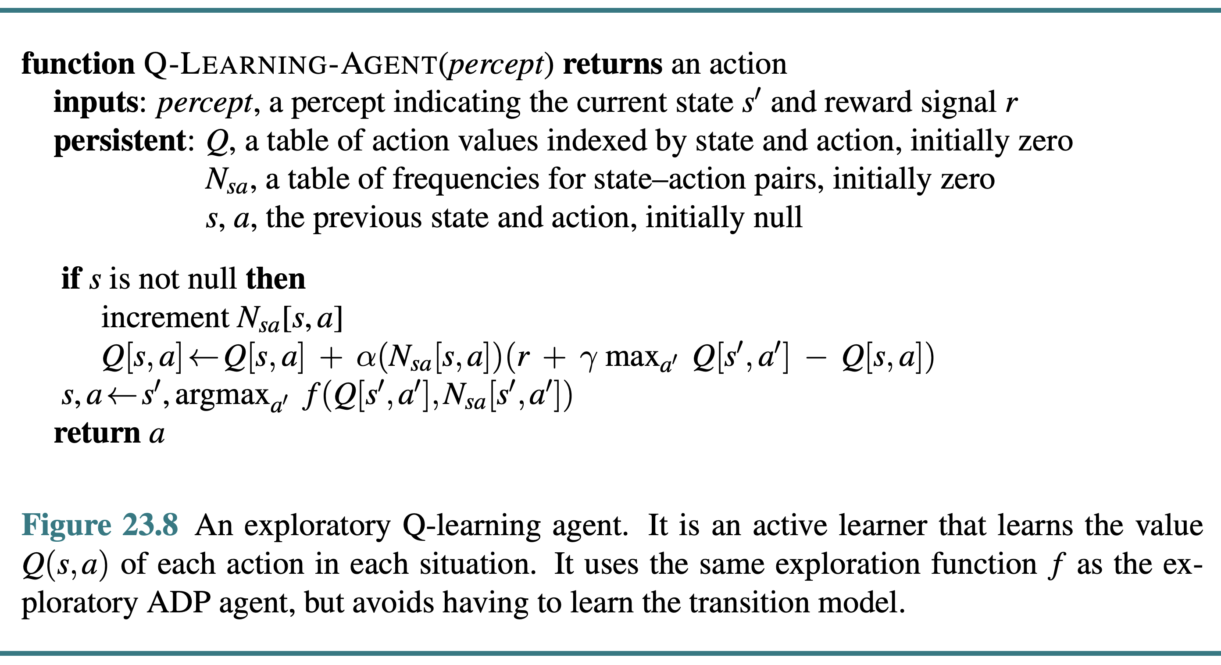
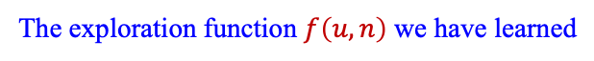
17.3 Active Reinforcement Learning (8/8)
Temporal-difference Q-learning
The exploration function $f\left(u,n\right)$ we have learned
<출처> Stuart J. Russell and Peter Norvig (2021). Artificial Intelligence: A Modern Approach (4th Edition). Pearson

Slide 29
17.4 Generalization in Reinforcement
Learning

Slide 30
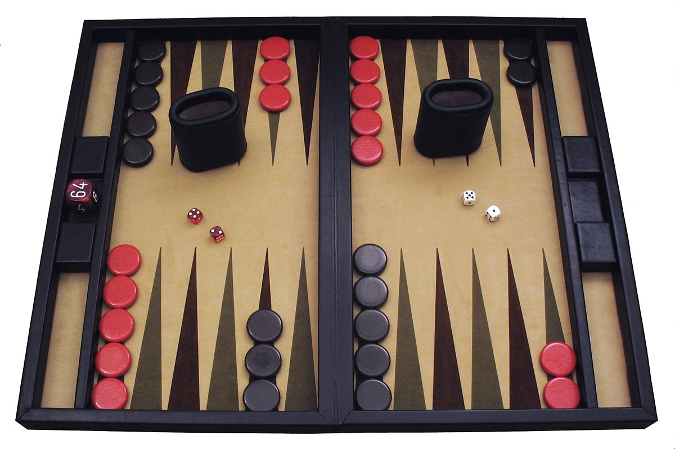
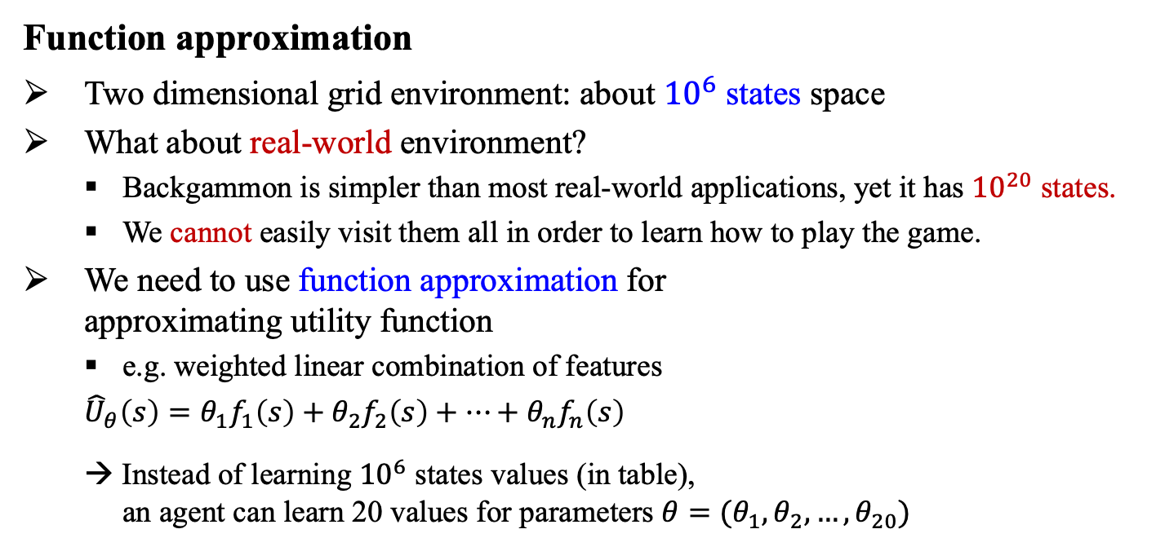
17.4 Generalization in Reinforcement Learning (1/6)
Function approximation
Two dimensional grid environment: about ${10}^{6}$ states space
What about real-world environment?
Backgammon is simpler than most real-world applications, yet it has ${10}^{20}$ states.
We cannot easily visit them all in order to learn how to play the game.
We need to use function approximation for approximating utility function
e.g. weighted linear combination of features
${\hat{U}}_{θ}\left(s\right)=θ_{1}f_{1}\left(s\right)+θ_{2}f_{2}\left(s\right)+…+θ_{n}f_{n}\left(s\right)$
→ Instead of learning ${10}^{6}$ states values (in table), an agent can learn 20 values for parameters $θ=(θ_{1},θ_{2},…,θ_{20})$

Slide 31
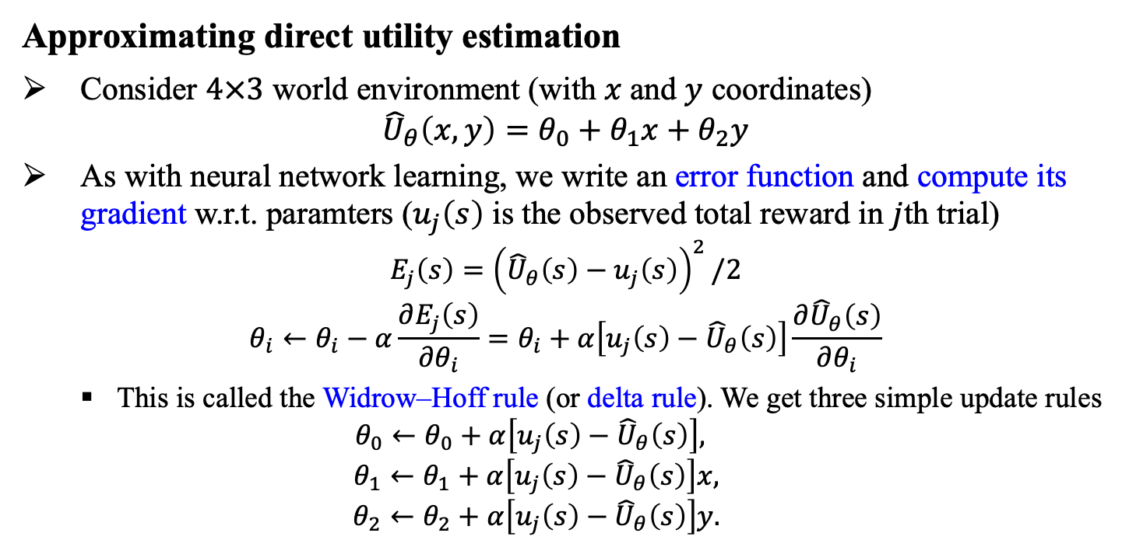
17.4 Generalization in Reinforcement Learning (2/6)
Approximating direct utility estimation
Consider $4×3$ world environment (with $x$and $y$ coordinates)
$${\hat{U}}_{θ}\left(x,y\right)=θ_{0}+θ_{1}x+θ_{2}y$$
As with neural network learning, we write an error function and compute its gradient w.r.t. paramters ($u_{j}\left(s\right)$ is the observed total reward in $j$th trial)
$$E_{j}\left(s\right)={\left({\hat{U}}_{θ}\left(s\right)−u_{j}\left(s\right)\right)}^{2}/2$$
$$θ_{i}←θ_{i}−α\frac{∂E_{j}\left(s\right)}{∂θ_{i}}=θ_{i}+α\left[u_{j}\left(s\right)−{\hat{U}}_{θ}\left(s\right)\right]\frac{∂{\hat{U}}_{θ}\left(s\right)}{∂θ_{i}}$$
This is called the Widrow–Hoff rule (or delta rule). We get three simple update rules
$$θ_{0}←θ_{0}+α\left[u_{j}\left(s\right)−{\hat{U}}_{θ}\left(s\right)\right],$$
$$θ_{1}←θ_{1}+α\left[u_{j}\left(s\right)−{\hat{U}}_{θ}\left(s\right)\right]x,$$
$$θ_{2}←θ_{2}+α\left[u_{j}\left(s\right)−{\hat{U}}_{θ}\left(s\right)\right]y.$$

Slide 32
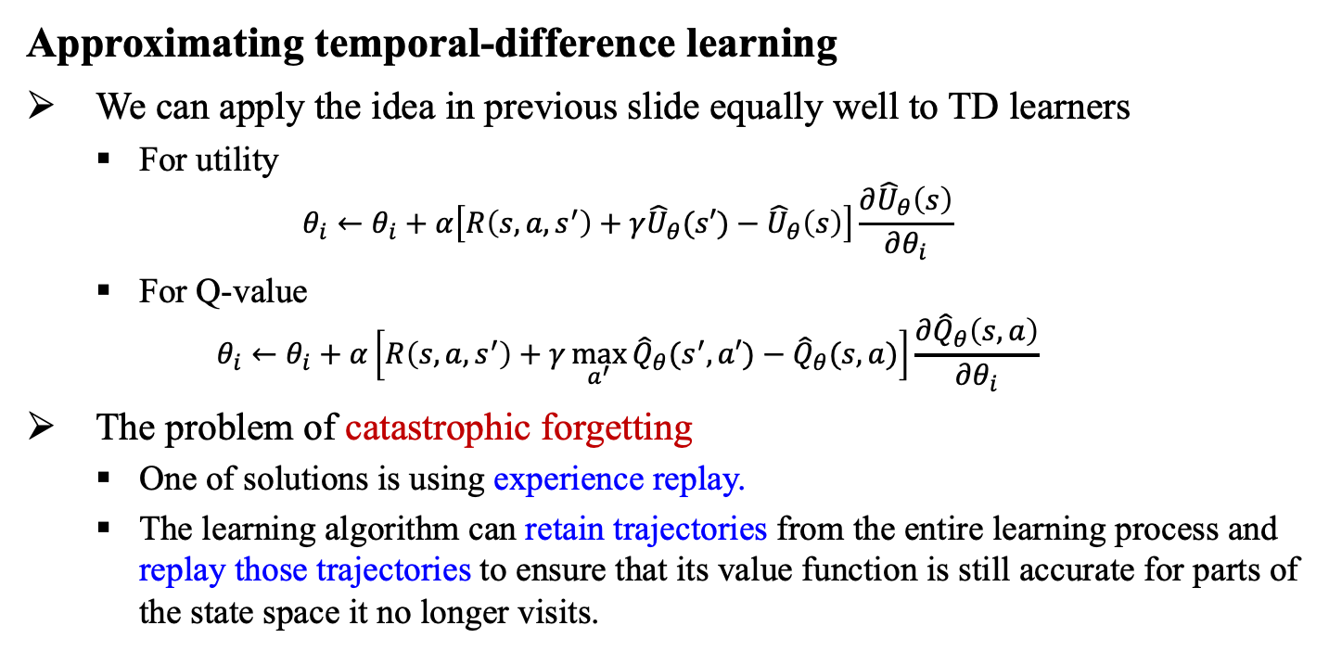
17.4 Generalization in Reinforcement Learning (3/6)
Approximating temporal-difference learning
We can apply the idea in previous slide equally well to TD learners
For utility
$$θ_{i}←θ_{i}+α\left[R\left(s,a,s^{′}\right)+γ{\hat{U}}_{θ}(s′)−{\hat{U}}_{θ}\left(s\right)\right]\frac{∂{\hat{U}}_{θ}\left(s\right)}{∂θ_{i}}$$
For Q-value
$$θ_{i}←θ_{i}+α\left[R\left(s,a,s^{′}\right)+γ\max_{a^{′}}{{\hat{Q}}_{θ}(s^{′},a′)}−{\hat{Q}}_{θ}(s,a)\right]\frac{∂{\hat{Q}}_{θ}\left(s,a\right)}{∂θ_{i}}$$
The problem of catastrophic forgetting
One of solutions is using experience replay.
The learning algorithm can retain trajectories from the entire learning process and replay those trajectories to ensure that its value function is still accurate for parts of the state space it no longer visits.

Slide 33
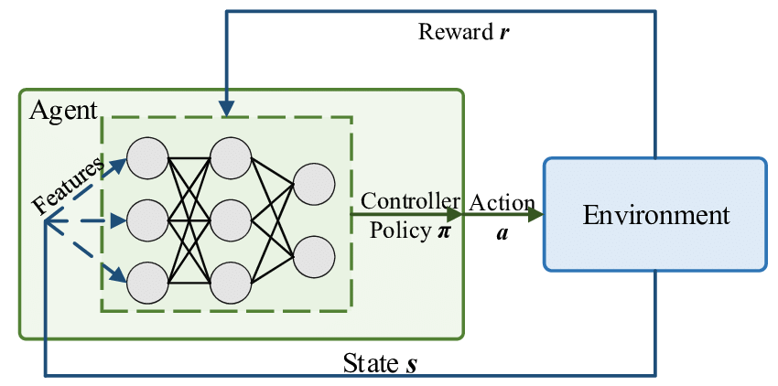
17.4 Generalization in Reinforcement Learning (4/6)
Deep reinforcement learning
The linear approximator may be insufficient → Use deep neural networks!
e.g. Video games, AlphaGo, training robots etc.
<출처> Gu et al., Machine Learning for Intelligent Optical Networks: A Comprehensive Survey

Slide 34
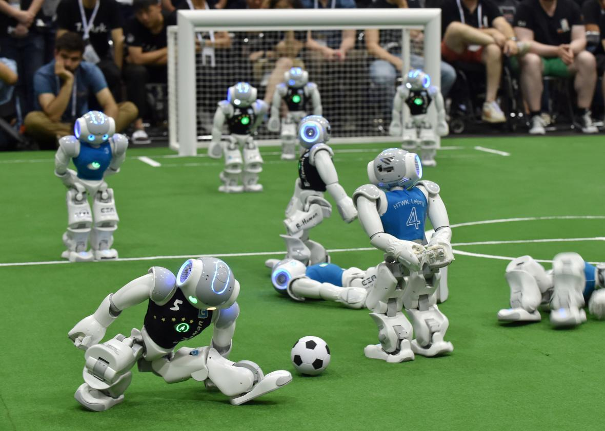
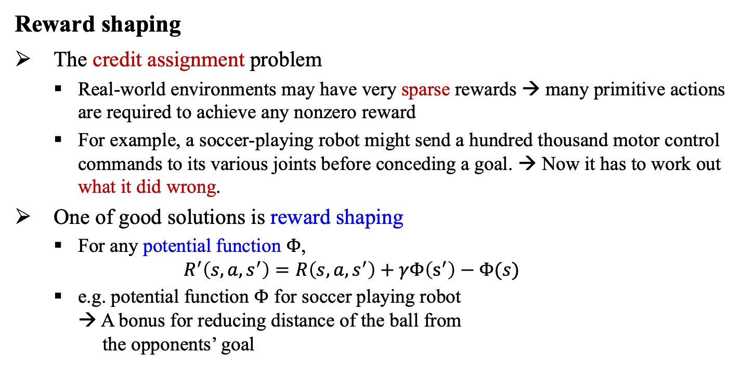
17.4 Generalization in Reinforcement Learning (5/6)
Reward shaping
The credit assignment problem
Real-world environments may have very sparse rewards → many primitive actions are required to achieve any nonzero reward
For example, a soccer-playing robot might send a hundred thousand motor control commands to its various joints before conceding a goal. → Now it has to work out what it did wrong.
One of good solutions is reward shaping
For any potential function $Φ$,
$$R^{′}\left(s,a,s^{′}\right)=R\left(s,a,s^{′}\right)+γΦ\left(s^{′}\right)−Φ(s)$$
e.g. potential function $Φ$ for soccer playing robot → A bonus for reducing distance of the ball from the opponents’ goal

Slide 35
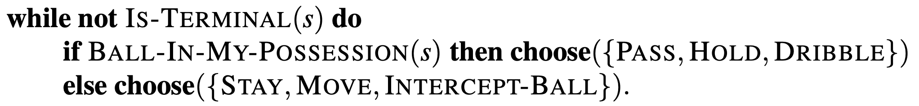
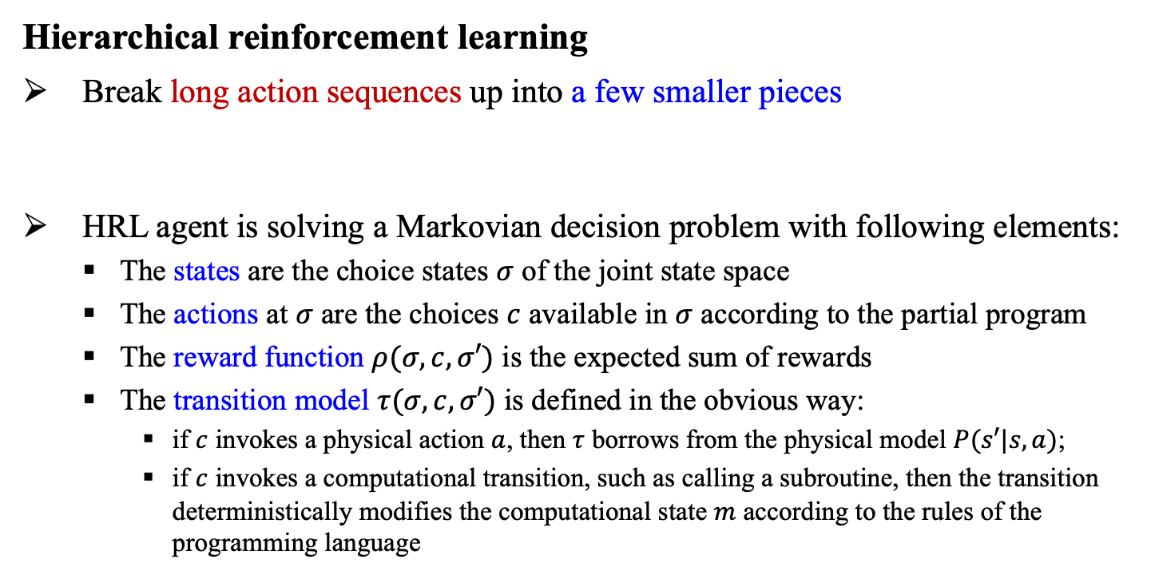
17.4 Generalization in Reinforcement Learning (6/6)
Hierarchical reinforcement learning
Break long action sequences up into a few smaller pieces
HRL agent is solving a Markovian decision problem with following elements:
The states are the choice states $σ$ of the joint state space
The actions at $σ$ are the choices $c$ available in $σ$ according to the partial program
The reward function $ρ(σ, c,σ′)$ is the expected sum of rewards
The transition model $τ(σ, c,σ′)$ is defined in the obvious way:
if $c$ invokes a physical action $a$, then $τ$ borrows from the physical model $P(s′|s,a)$;
if $c$ invokes a computational transition, such as calling a subroutine, then the transition deterministically modifies the computational state $m$ according to the rules of the programming language

Slide 36
17.5 Policy Search

Slide 37
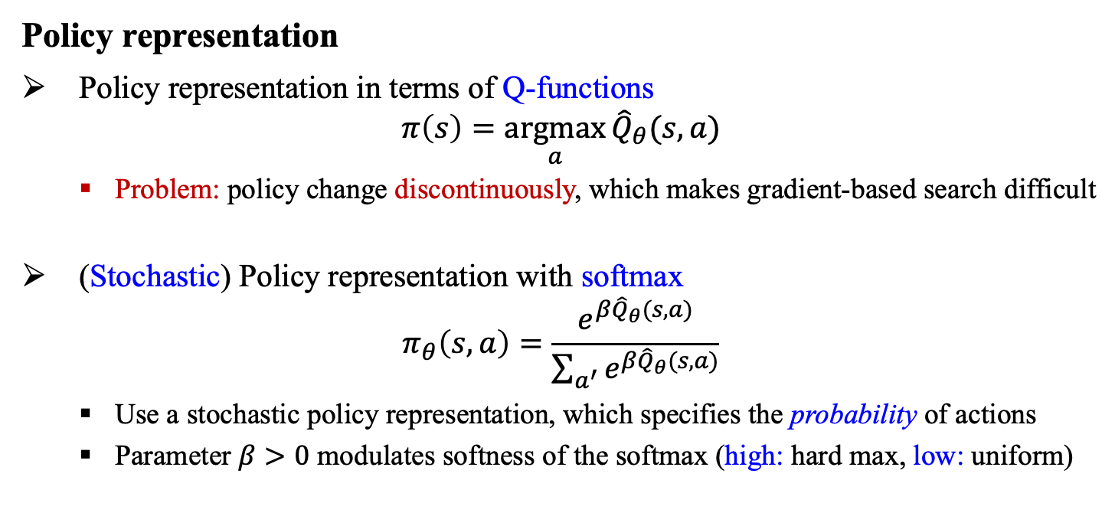
17.5 Policy Search (1/2)
Policy representation
Policy representation in terms of Q-functions
$$π\left(s\right)=\underset{a}{argmax}{{\hat{Q}}_{θ}(s,a)}$$
Problem: policy change discontinuously, which makes gradient-based search difficult
(Stochastic) Policy representation with softmax
$$π_{θ}\left(s,a\right)=\frac{e^{β{\hat{Q}}_{θ}(s,a)}}{\sum_{a^{′}}{e^{β{\hat{Q}}_{θ}(s,a)}}}$$
Use a stochastic policy representation, which specifies the probability of actions
Parameter $β>0$ modulates softness of the softmax (high: hard max, low: uniform)

Slide 38
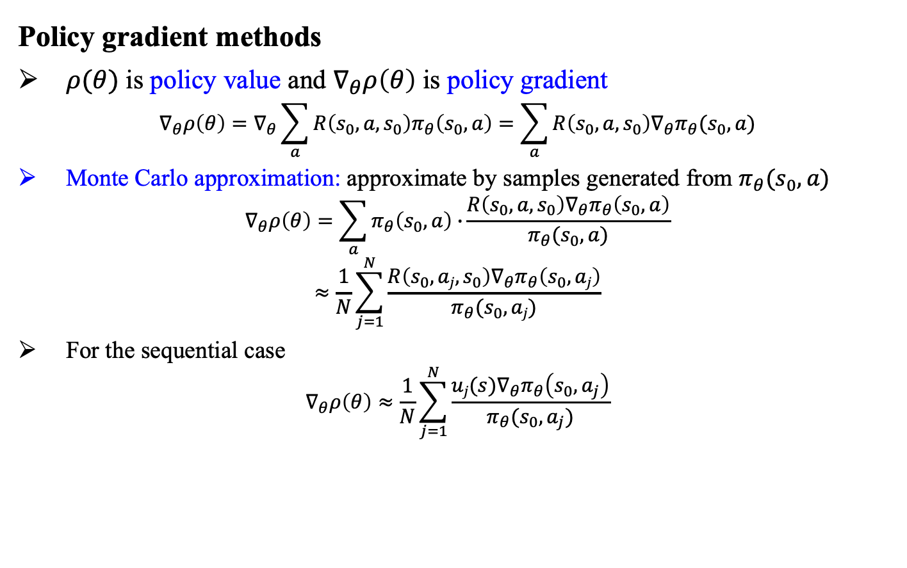
17.5 Policy Search (2/2)
Policy gradient methods
$ρ(θ)$ is policy value and $∇_{θ}ρ\left(θ\right)$ is policy gradient
$$∇_{θ}ρ\left(θ\right)=∇_{θ}\sum_{a}{R\left(s_{0},a,s_{0}\right)π_{θ}\left(s_{0},a\right)=\sum_{a}{R\left(s_{0},a,s_{0}\right)∇_{θ}π_{θ}(s_{0},a)}}$$
Monte Carlo approximation: approximate by samples generated from $π_{θ}(s_{0},a)$
$$∇_{θ}ρ\left(θ\right)=\sum_{a}{π_{θ}\left(s_{0},a\right)∙}\frac{{R\left(s_{0},a,s_{0}\right)∇}_{θ}π_{θ}\left(s_{0},a\right)}{π_{θ}(s_{0},a)}$$
$$≈\frac{1}{N}\sum_{j=1}^{N}{\frac{{R\left(s_{0},aj,s_{0}\right)∇}_{θ}π_{θ}\left(s_{0},aj\right)}{π_{θ}(s_{0},aj)}}$$
For the sequential case
$$∇_{θ}ρ\left(θ\right)≈\frac{1}{N}\sum_{j=1}^{N}{\frac{{uj(s)∇}_{θ}π_{θ}\left(s_{0},a_{j}\right)}{π_{θ}(s_{0},a_{j})}}$$

Slide 39
17.6 Apprenticeship and Inverse Reinforcement Learning

Slide 40
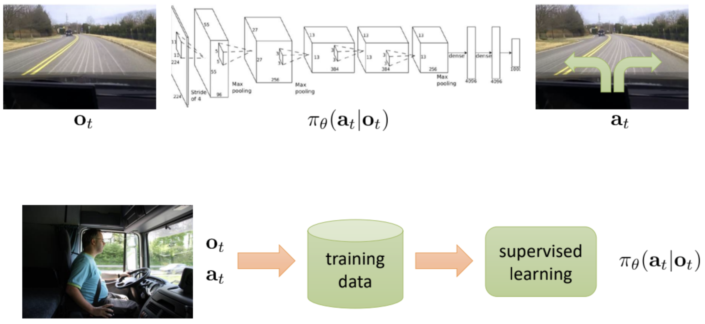
17.6 Apprenticeship and Inverse RL (1/2)
Apprenticeship learning
How to behave well given observations of expert behavior
We can apply supervised learning using state-action pairs to learn policy → Imitation learning
<출처> Bojarski et al. ‘16, NVIDIA

Slide 41
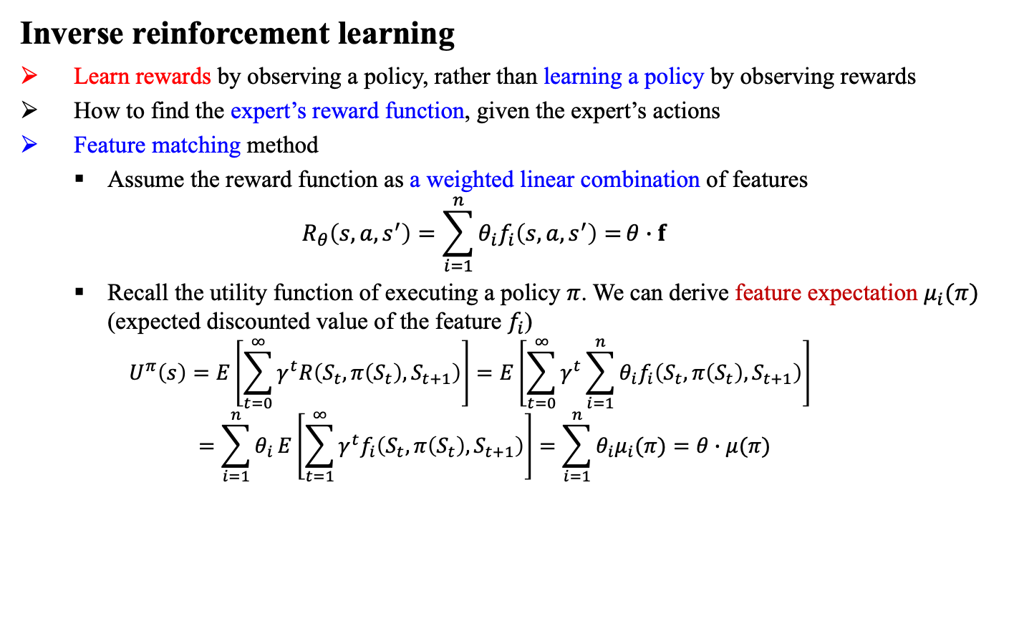
17.6 Apprenticeship and Inverse RL (2/2)
Inverse reinforcement learning
Learn rewards by observing a policy, rather than learning a policy by observing rewards
How to find the expert’s reward function, given the expert’s actions
Feature matching method
Assume the reward function as a weighted linear combination of features
$$R_{θ}\left(s,a,s^{′}\right)=\sum_{i=1}^{n}{θ_{i}f_{i}\left(s,a,s^{′}\right)=}θ∙f$$
Recall the utility function of executing a policy $π$. We can derive feature expectation $μ_{i}(π)$ (expected discounted value of the feature $f_{i}$)
$$U^{π}\left(s\right)=E\left[\sum_{t=0}^{∞}{γ^{t}R\left(S_{t},π\left(S_{t}\right),S_{t+1}\right)}\right]=E\left[\sum_{t=0}^{∞}{γ^{t}}\sum_{i=1}^{n}{θ_{i}f_{i}\left(S_{t},π\left(S_{t}\right),S_{t+1}\right)}\right]$$
$$=\sum_{i=1}^{n}{θ_{i}}E\left[\sum_{t=1}^{∞}{γ^{t}f_{i}\left(S_{t},π\left(S_{t}\right),S_{t+1}\right)}\right]=\sum_{i=1}^{n}{θ_{i}μ_{i}(π)}=θ∙μ(π)$$

Slide 42
17.7 Applications of Reinforcement Learning

Slide 43
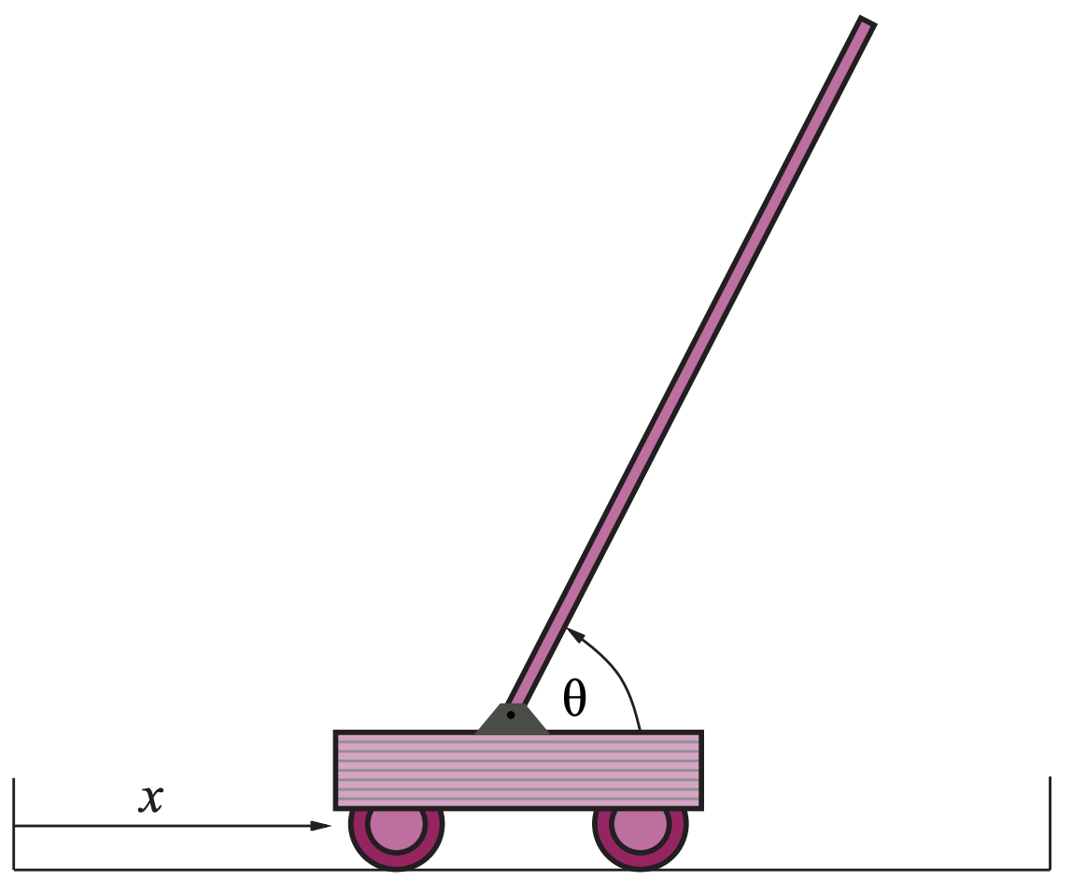
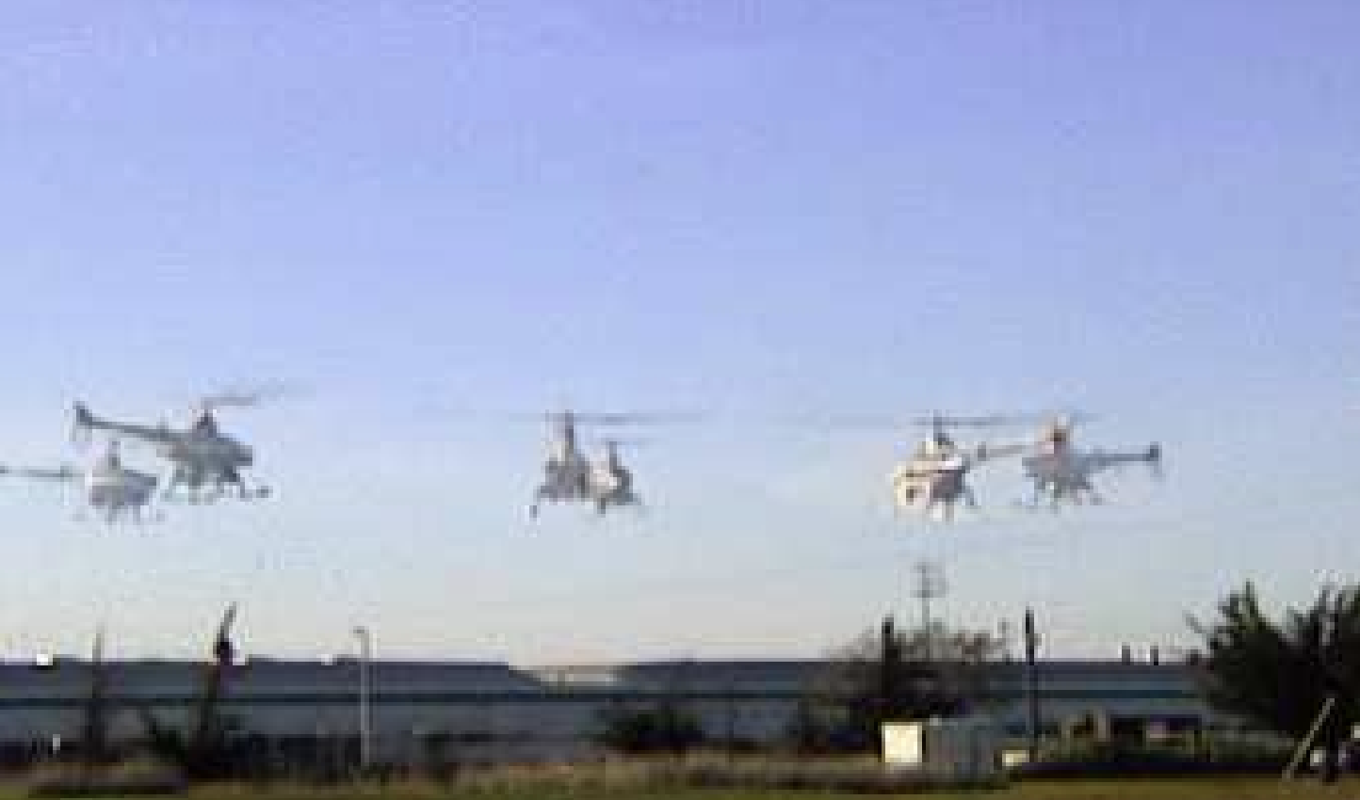
17.7 Applications of Reinforcement Learning (1/1)
Application of Reinforcement Learning
Game playing
Checker program written by Arthur Samuel (1959, 1967)
TD-GAMMON (Backgammon) program by Gerry Tesauro (1992)
AlphaGo program by Google DeepMind (2016)
Robot control
Cart-pole balancing problem by Michie and Chambers (1968)
Helicopter flight using policy search by Bagnell et al. (2001)
Deep RL for robotics and self-driving cars (2016~present)
Cart-pole balancing
Helicopter flight
<출처> Stuart J. Russell and Peter Norvig (2021). Artificial Intelligence: A Modern Approach (4th Edition). Pearson

Slide 44
Summary
Direct utility estimation uses the total observed reward-to-go for a given state as direct evidence for learning its utility.
A model-based reinforcement learning agent acquires a transition model for the environment and learns a utility function.
A model-free reinforcement learning agent may learn an action-utility function or a policy
Adaptive dynamic programming (ADP) learns a model and a reward function from observations and then uses value or policy iteration to obtain the utilities or an optimal policy.
Temporal difference (TD) methods update utility estimates to match those of successor states.
Action-utility functions (Q-functions) can be learned by an ADP approach or a TD approach.
Policy-search methods operate directly on a representation of the policy, attempting to improve it based on observed performance.
Apprenticeship learning through observation of expert behavior can be an effective solution when a correct reward function is hard to specify.
Imitation learning formulates the problem as supervised learning of a policy from the expert’s state-action pairs.
Inverse reinforcement learning infers reward information from the expert’s behavior.

